Slide 1
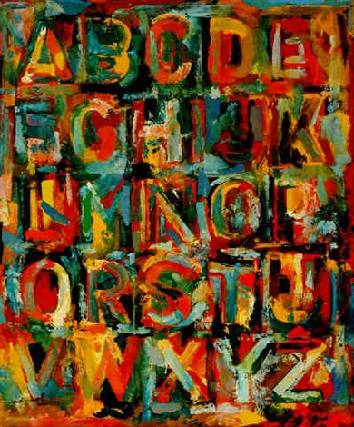
Jasper Johns
What do you notice about the art?

Slide 2
Your Name
Homeroom Teacher

Slide 3
Draw 2 vertical lines
Draw 3 horizontal lines
Draw the middle line first!

Slide 4
Sketchbook Project:
Draw a grid.
Fill each square with a drawing of something you love.

