Slide 1
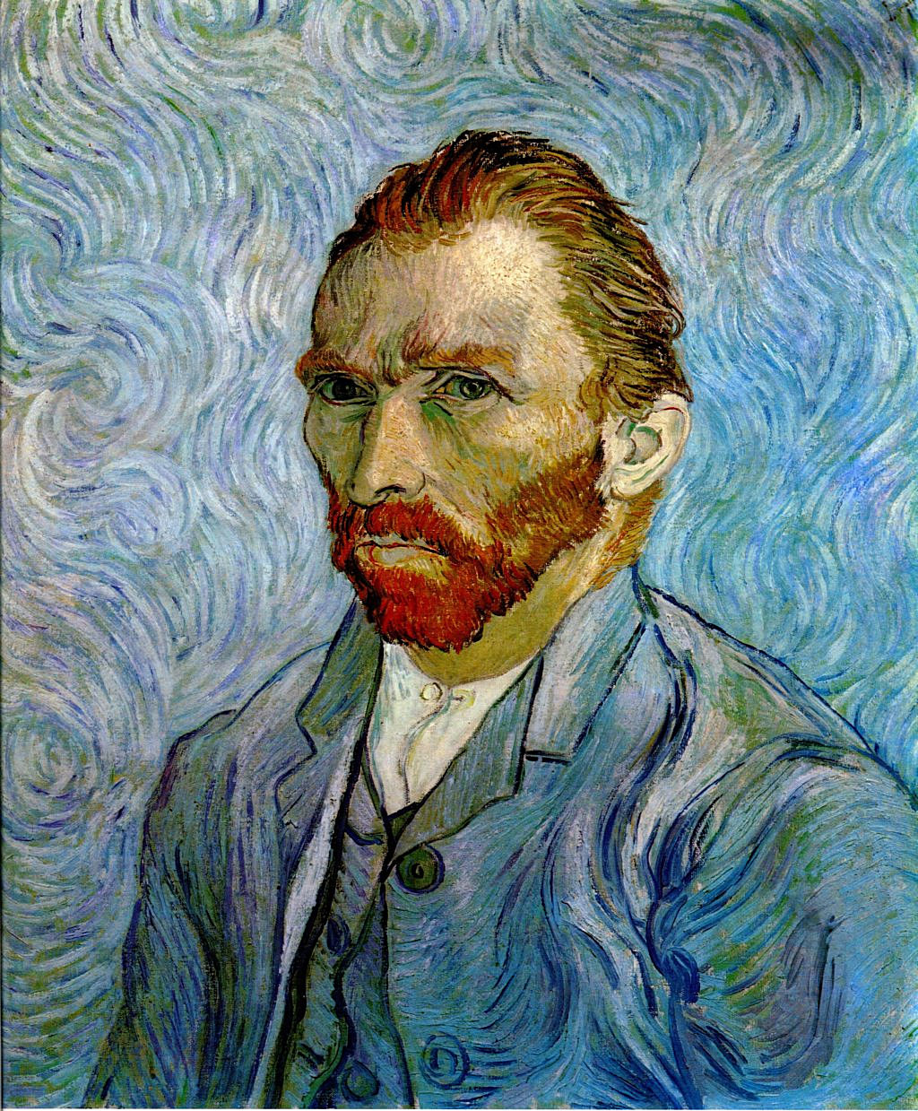
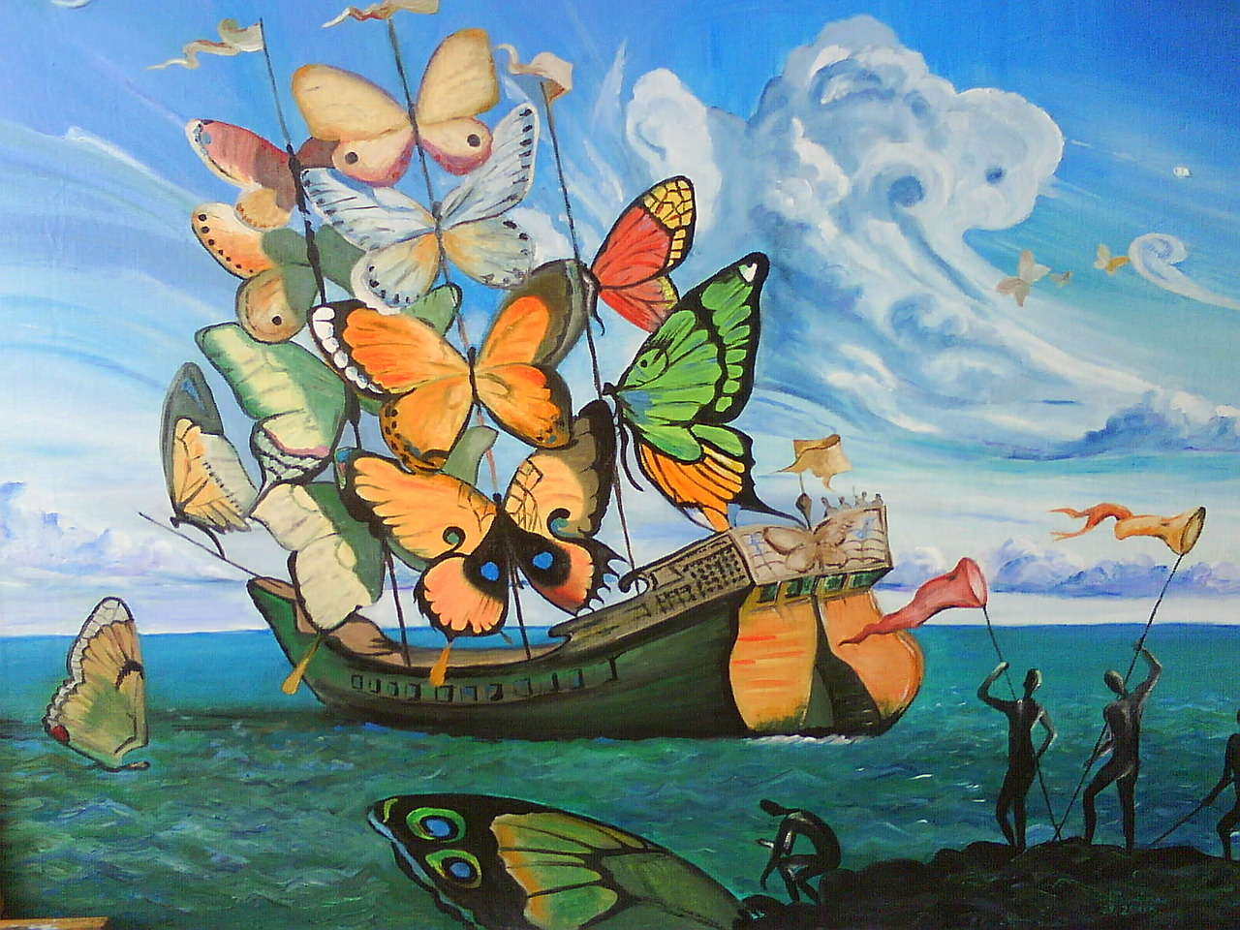
What is a self-portrait?
What does Surreal mean?

Slide 2
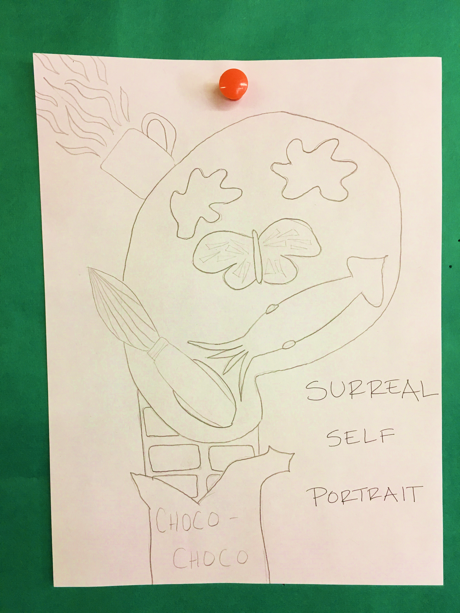
Draw a surreal self-portrait
by using things that represent you as the parts of your face.

