Slide 1
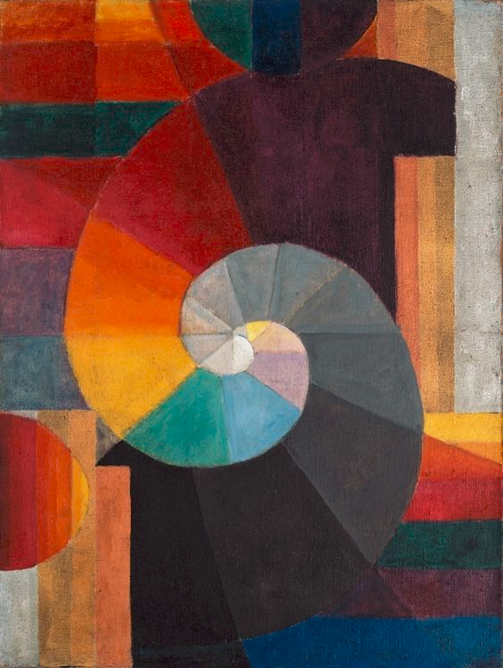
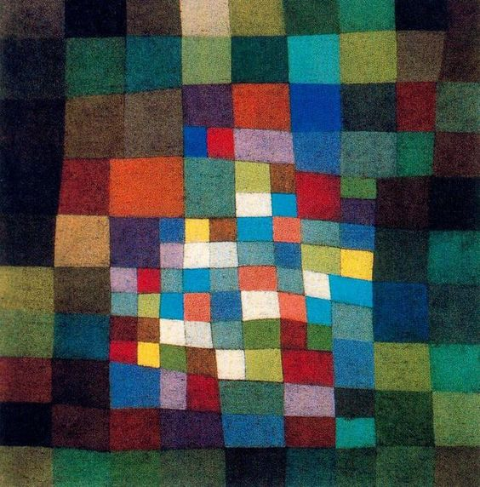
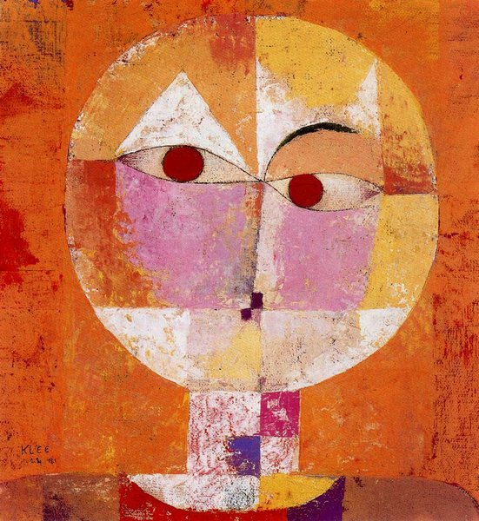
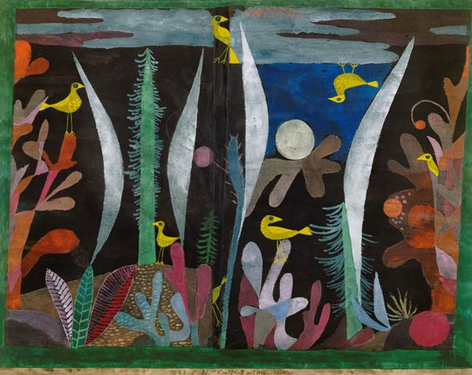
What do the paintings have in common?
How are they different?
Paul Klee

Slide 2
Realistic
Abstract

Slide 3
Abstract
Your Name
Homeroom Teacher
Realistic
Your Name
Homeroom Teacher

Slide 4
Day 1 Sketchbook Project –
Draw something that looks completely
opposite from Paul Klee’s artwork.

Slide 5
Day 2 Sketchbook Project –
Draw an abstract or realistic drawing.
Abstract
Realistic

