Slide 1
If you were a robot,
what would you look like?

Slide 2
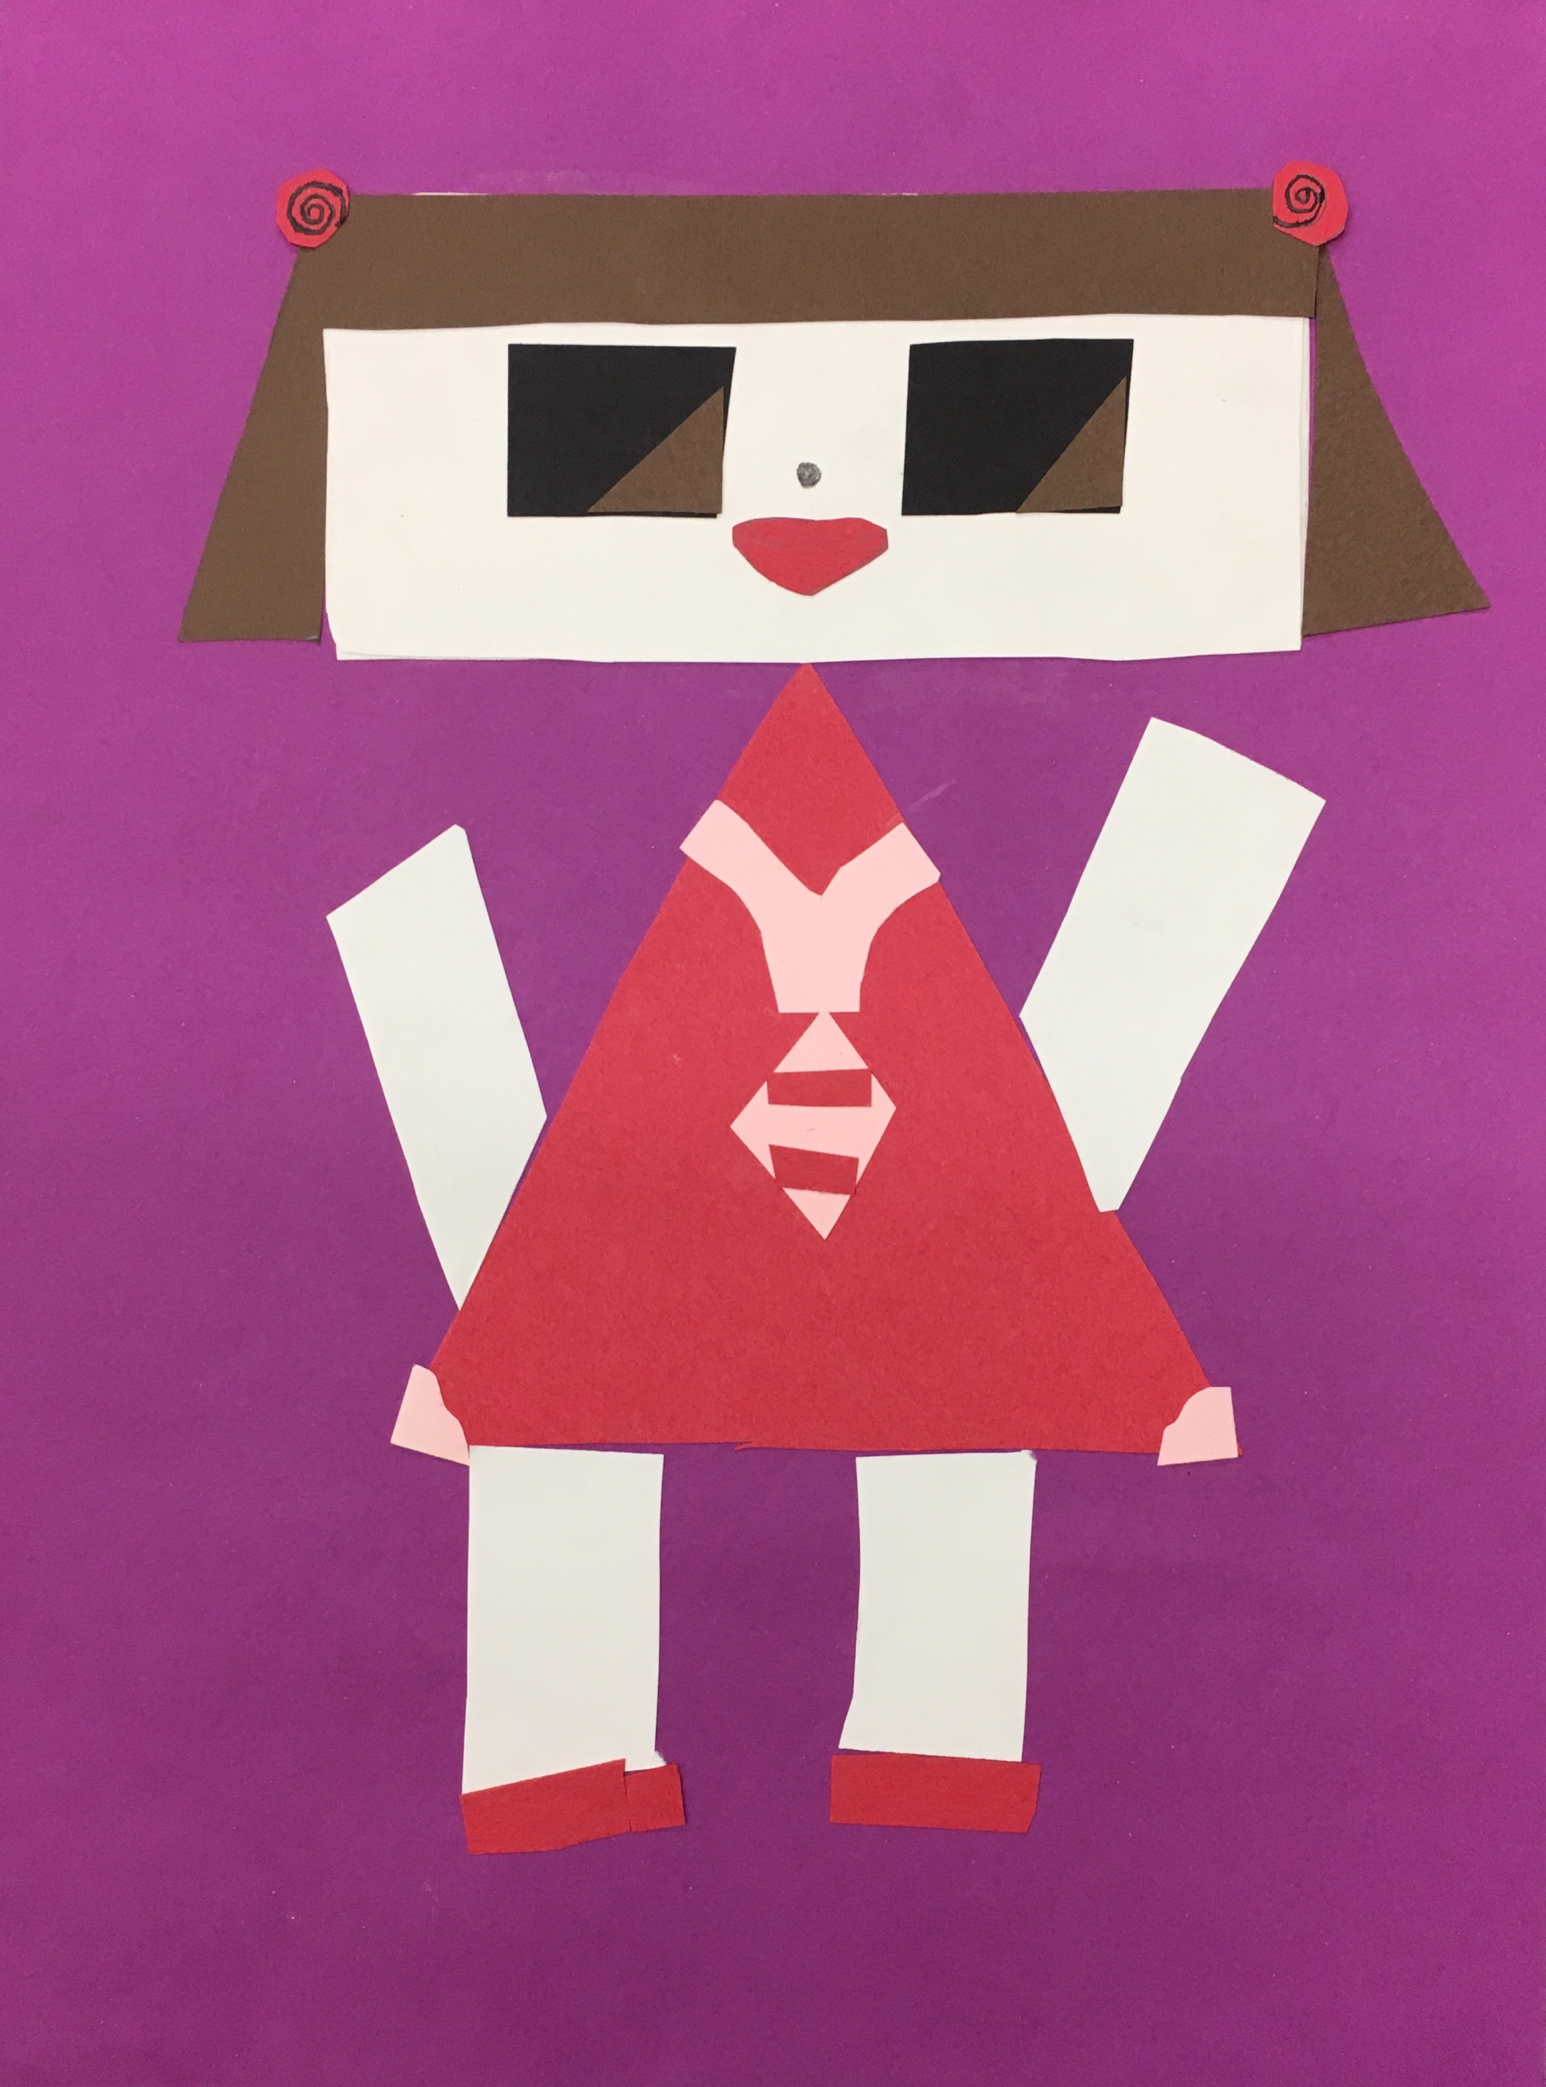
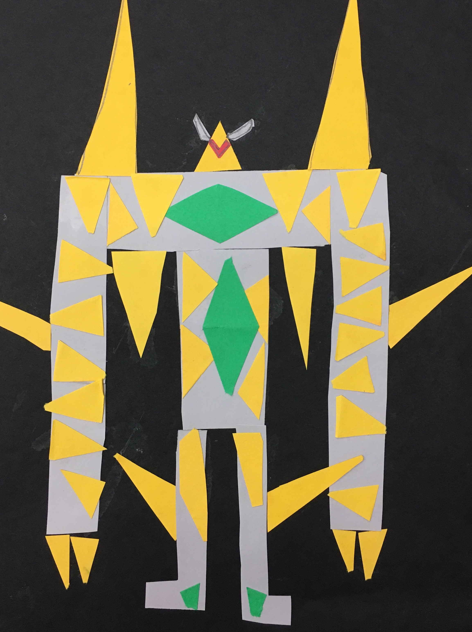
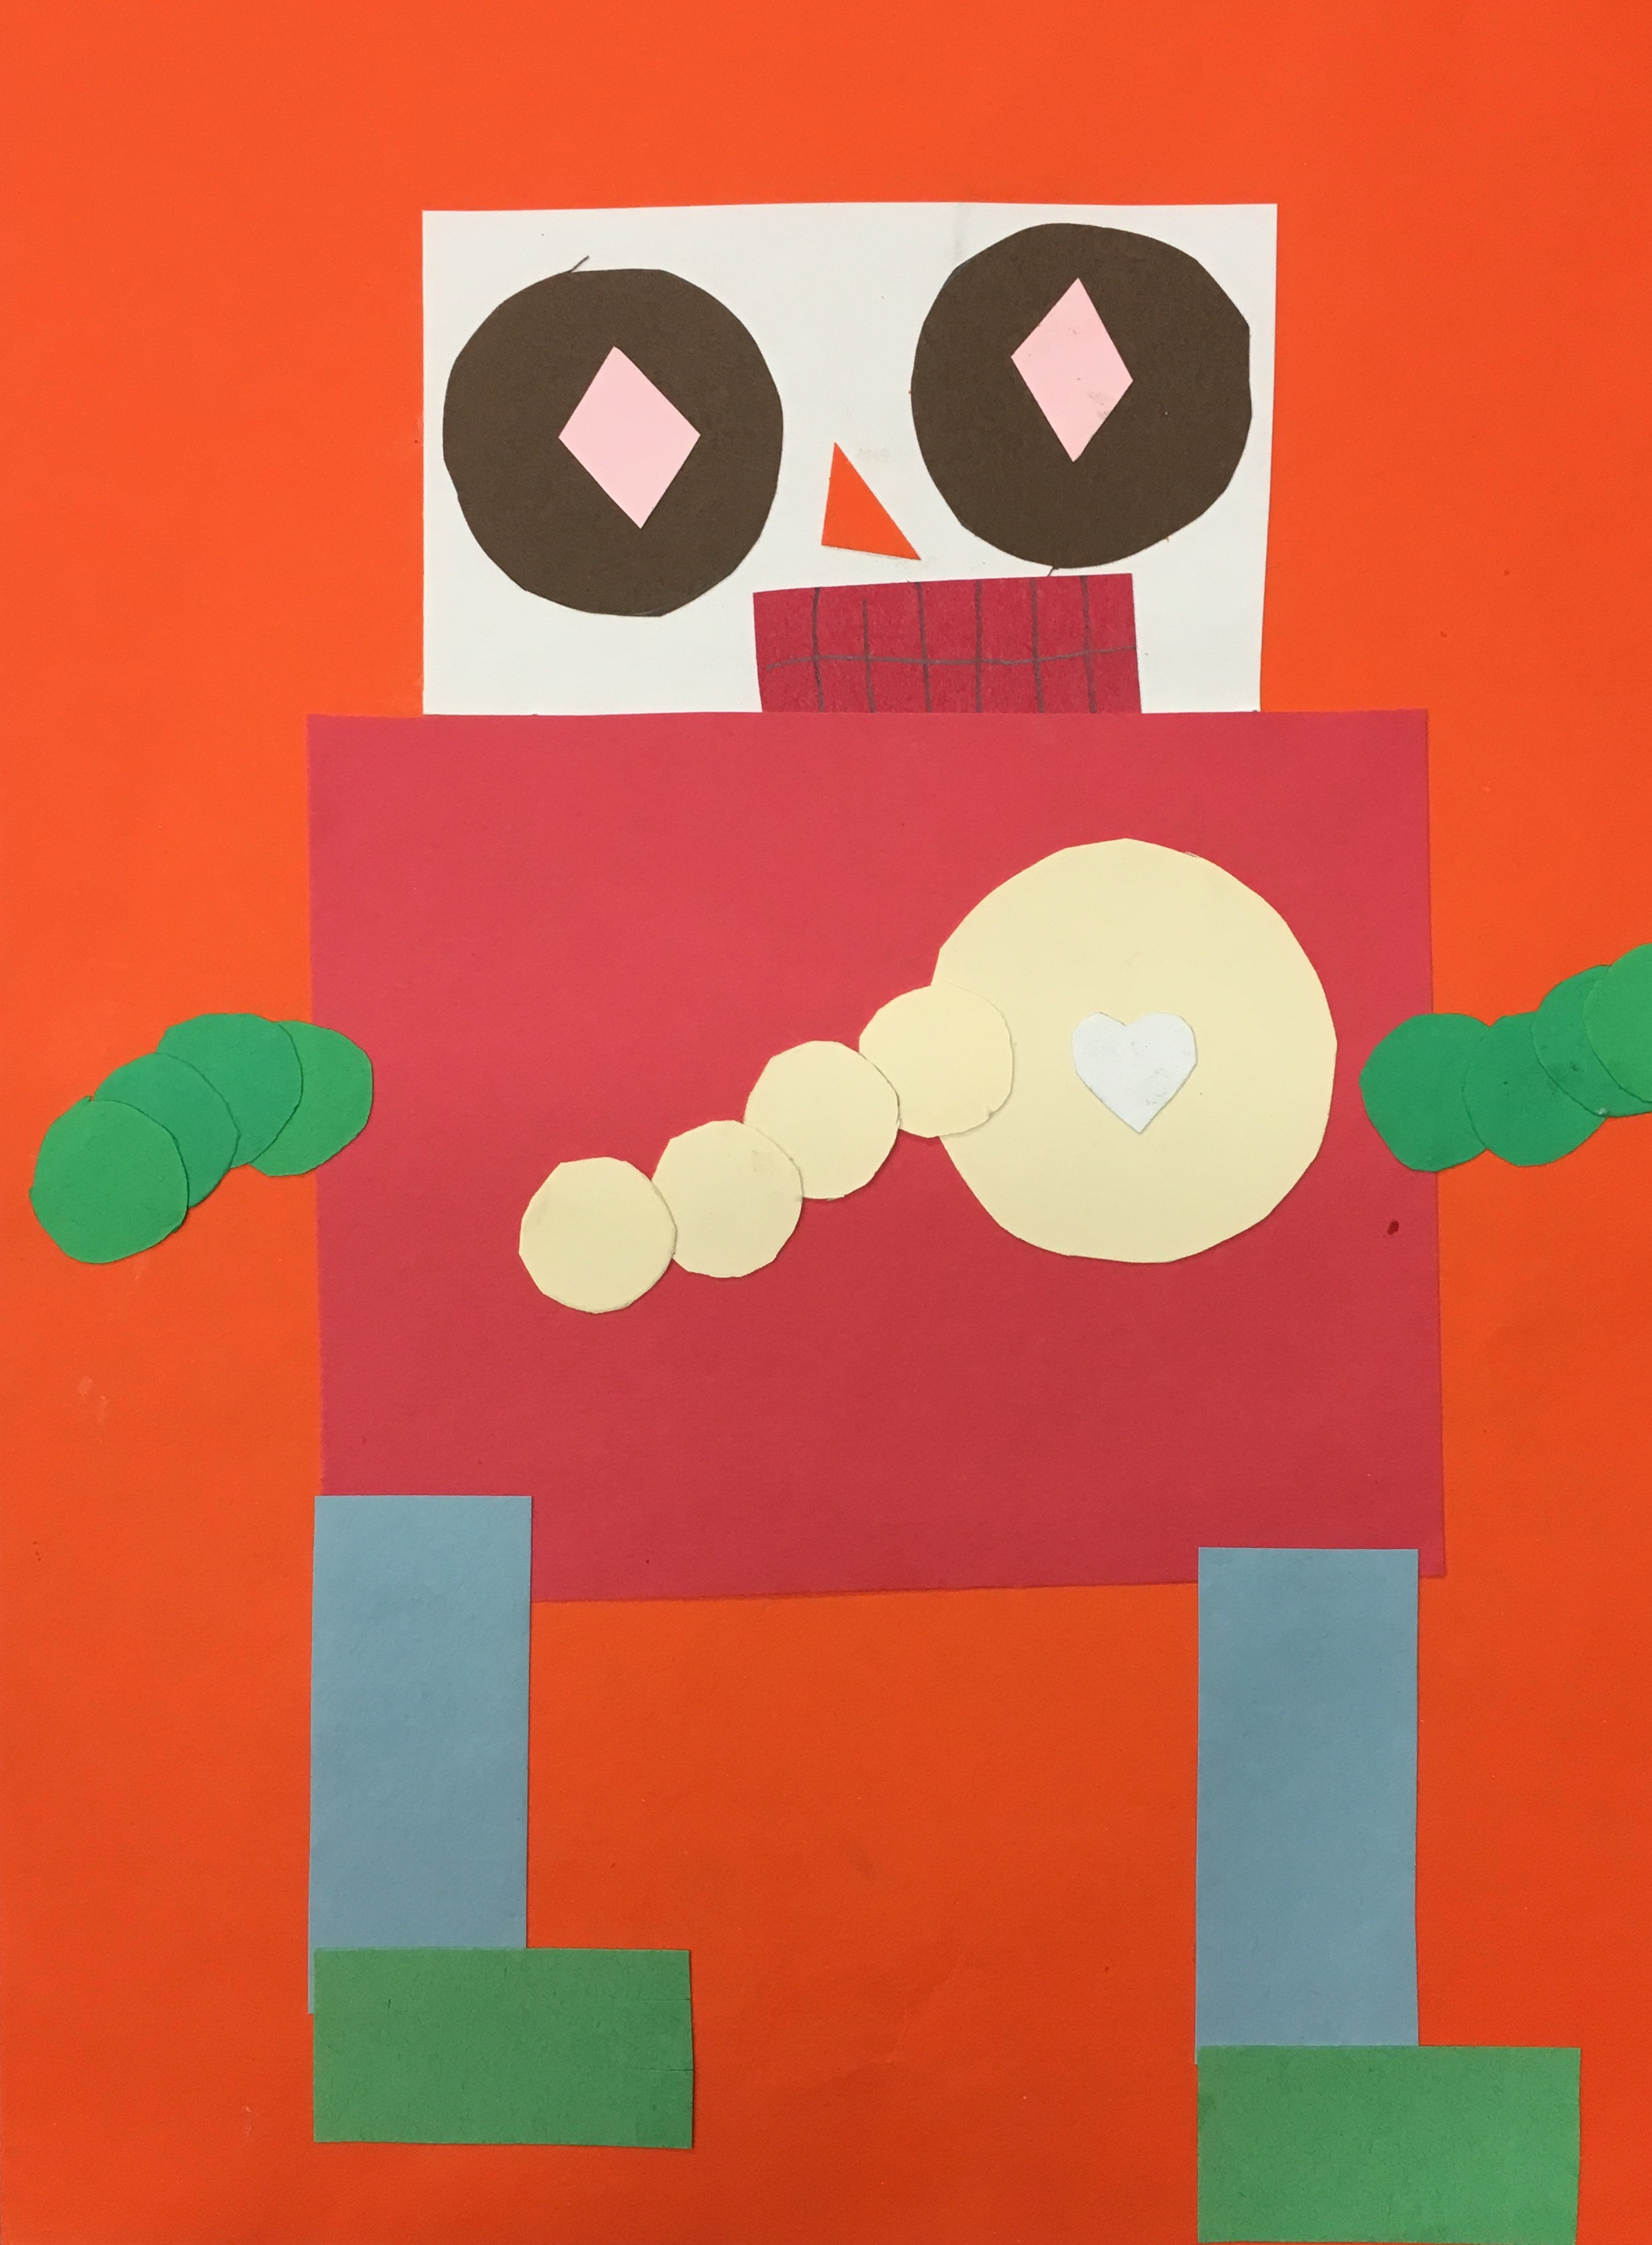
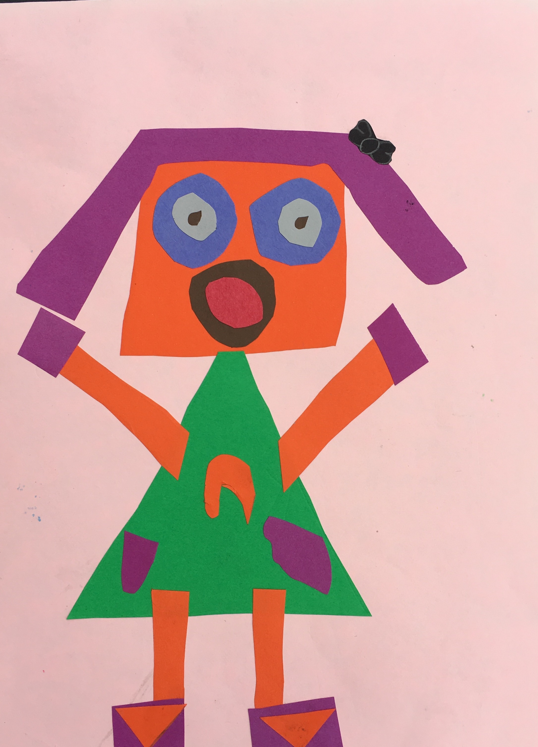
Add details by drawing
smaller shapes
inside
bigger shapes.

Slide 3
Your Name
Homeroom Teacher

Slide 4
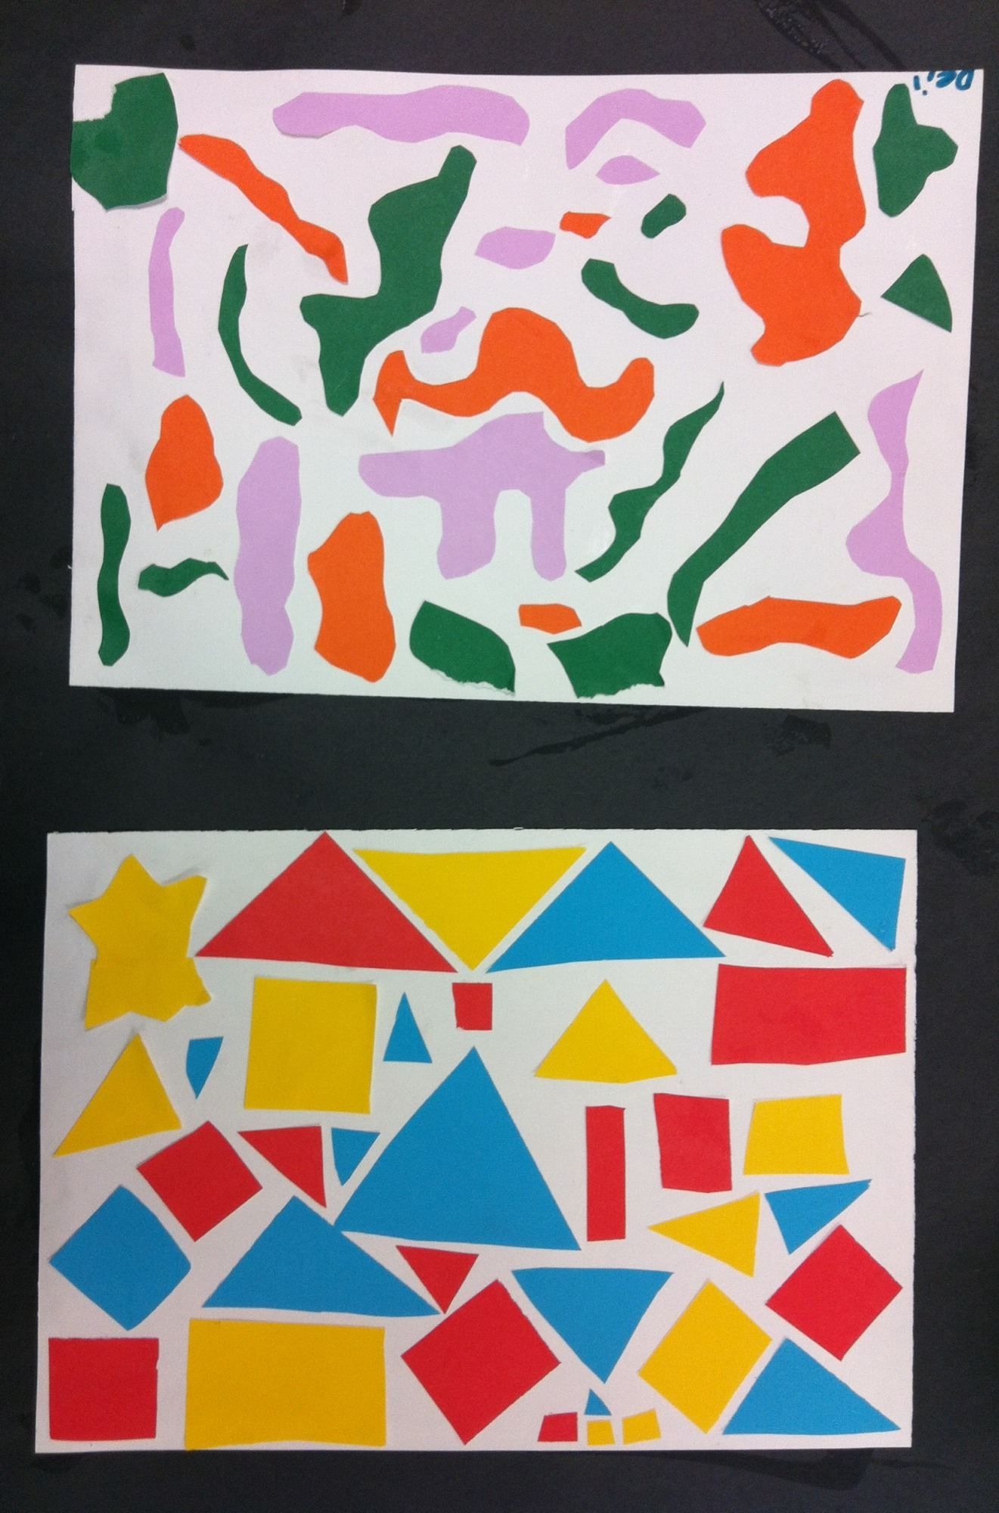
Which shapes are organic?
Which are geometric?

Slide 5
Sketchbook Project:
1. Finish designing your name on your sketchbook.
2. Draw your robot doing something. Fill the paper with an interesting background.
Your robot could be:
Flying a kite, making breakfast, taking a bath, playing a game…

