Slide 1
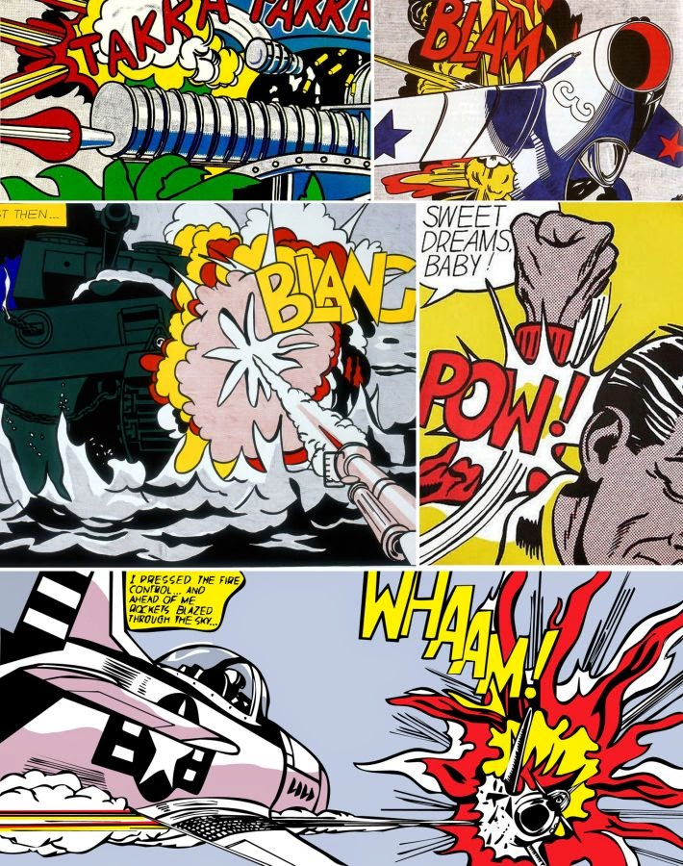
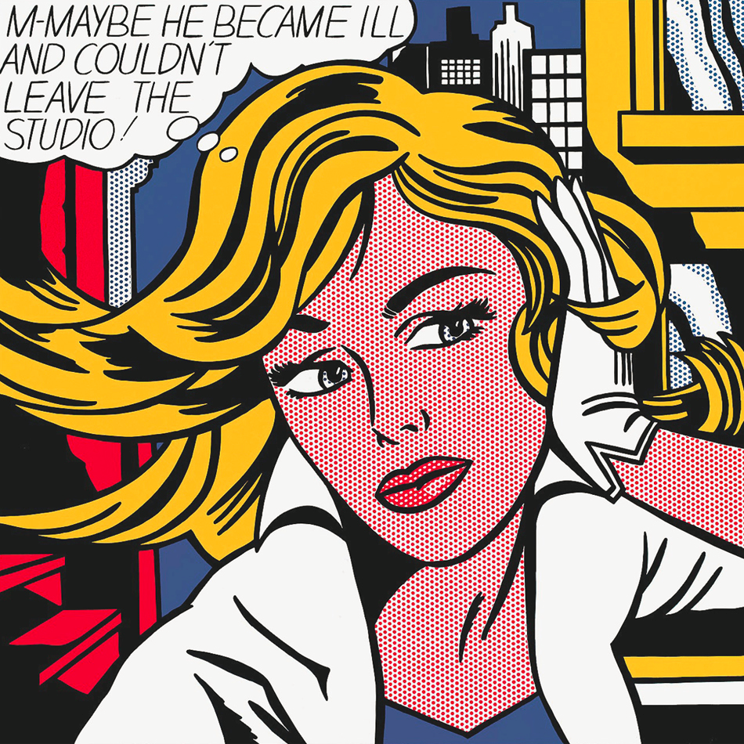
Lichtenstein took comic panels and re-created them as big paintings.

Slide 2
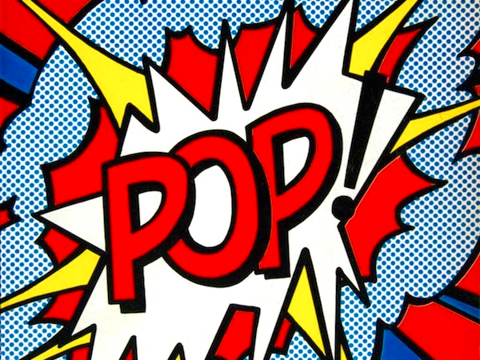
Pop Art:
Art inspired by popular culture.
(images from movies, TV, magazines, things you would find in the store…)

Slide 3
Word Art
Pick a word from the onomatopoeia list.
Sketch the word as bubble letters or block letters.
Fill the background with designs that remind you of your word.
Trace every line with Sharpie.

Slide 4
Your Name
Homeroom Teacher
Your Name
Homeroom Teacher

Slide 5

Painting Techniques
Pull your brush along the outline of a shape.
Re-load when the brush runs out of paint.
Clean your brush between colors!

Slide 6
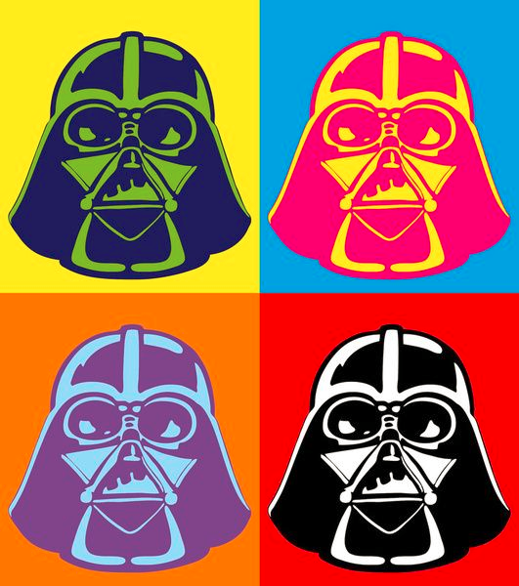
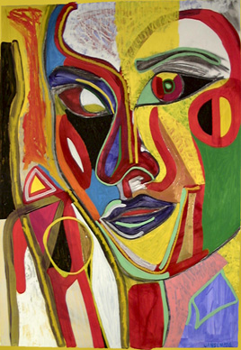
Which is an example of Pop Art? Why?

Slide 7
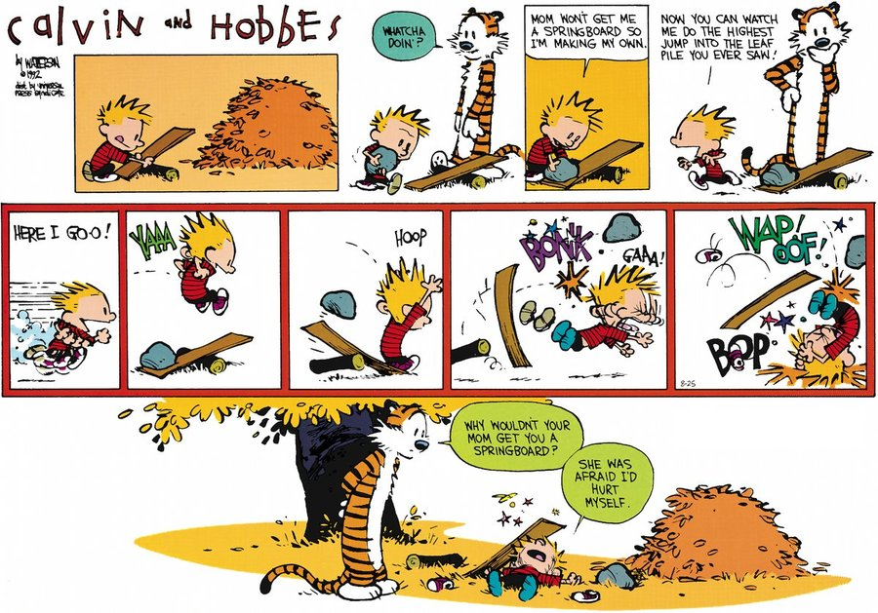
Sketchbook Project: Draw a comic. Color it with markers or colored pencils.

