Slide 1
What is a hybrid?
Day 1: Opening Question

Slide 2
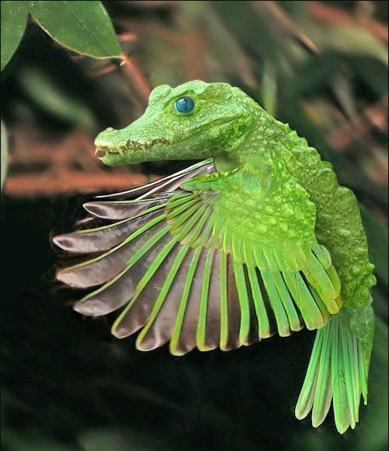
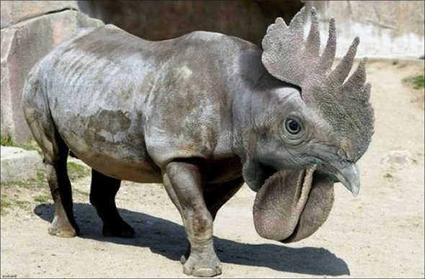
Head of one animal, body of another

Slide 3
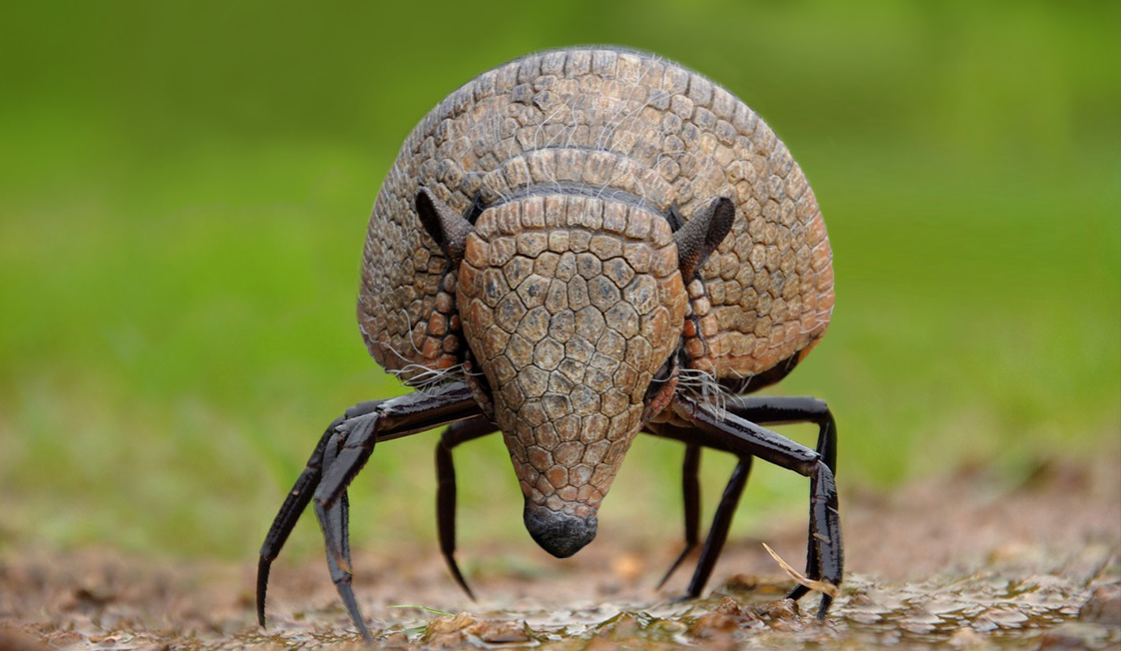
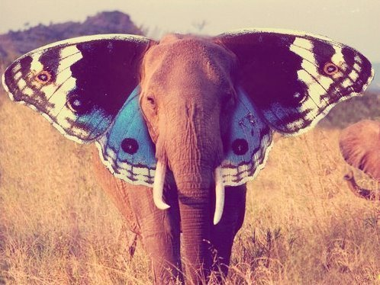
Mostly one animal, body part of another

Slide 4
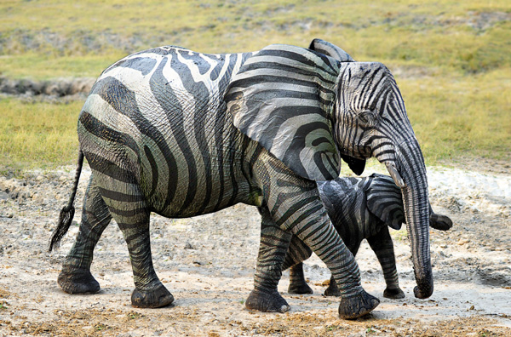
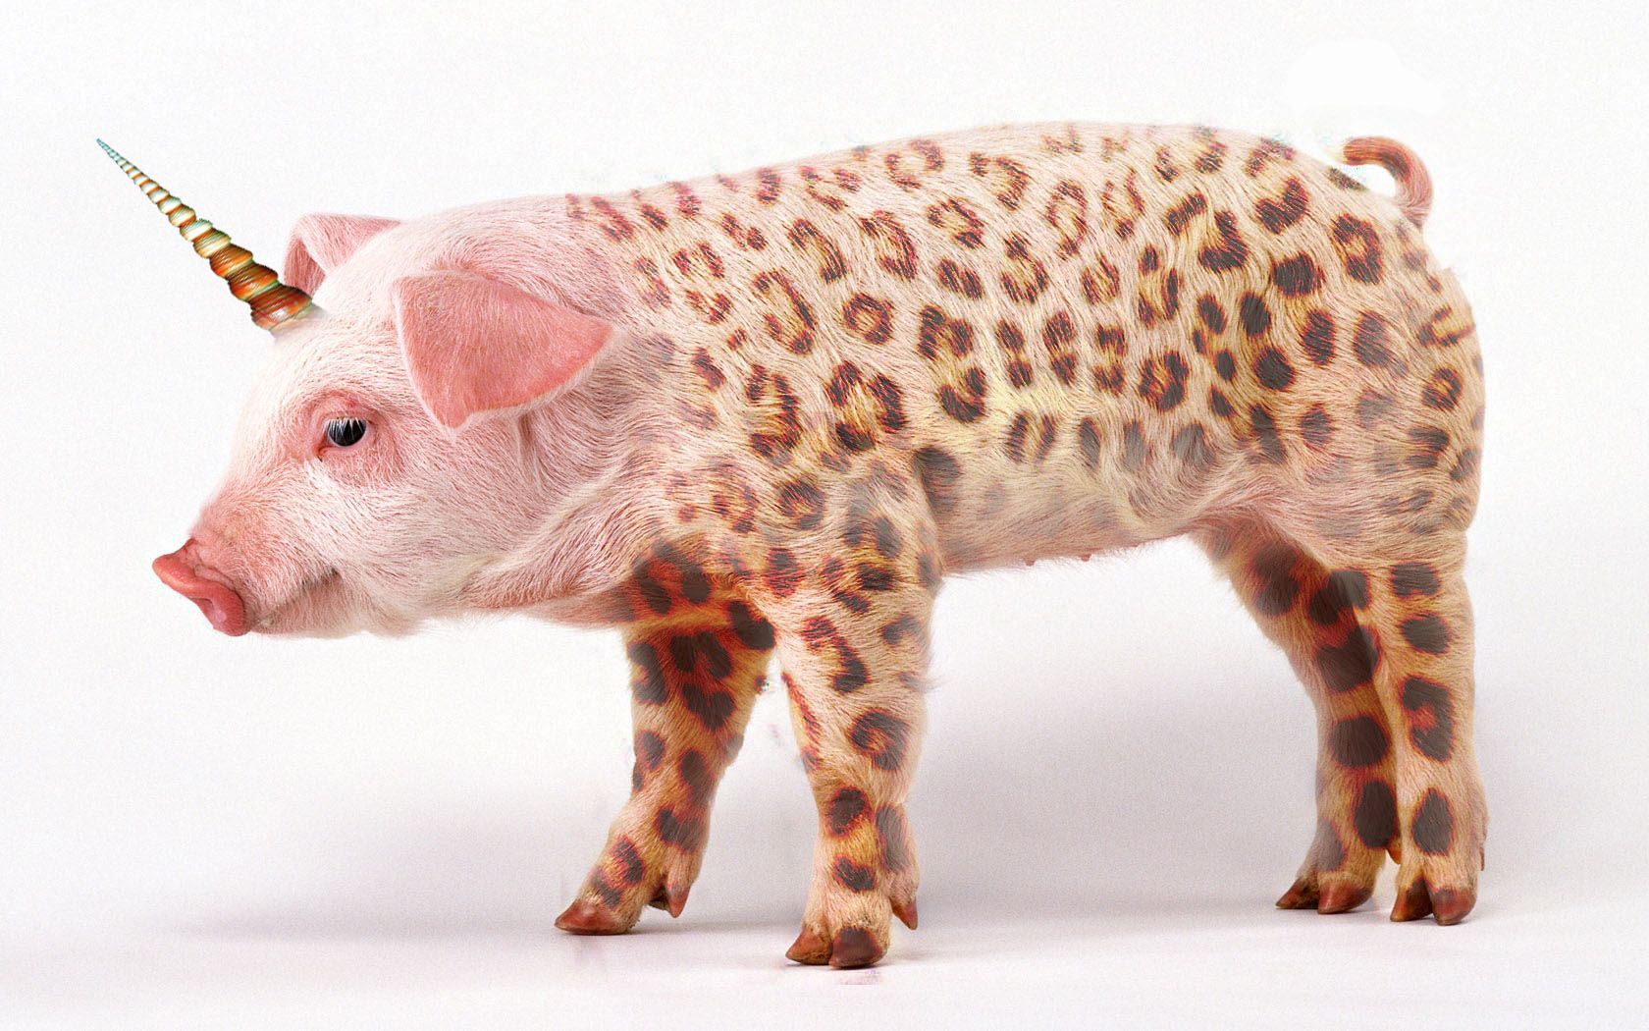
Body and head of one animal, skin pattern/texture of another

Slide 5
Name
Homeroom Teacher
Name
Homeroom Teacher

Slide 6
What can you do to
color neatly?
Day 2: Opening Question

Slide 7
What is your animal’s habitat?
Day 3: Opening Question

Slide 8
Sketchbook Project:
1. Finish previous sketchbook project.
2. Draw your animal at different stages in it’s life cycle.
Infant
Child
Teenager
Adult

Slide 9
Name – What is your animal’s name?
Diet – What does your animal eat?
Lifespan – How long does your animal live?
Day 4: Opening Question

