Slide 1
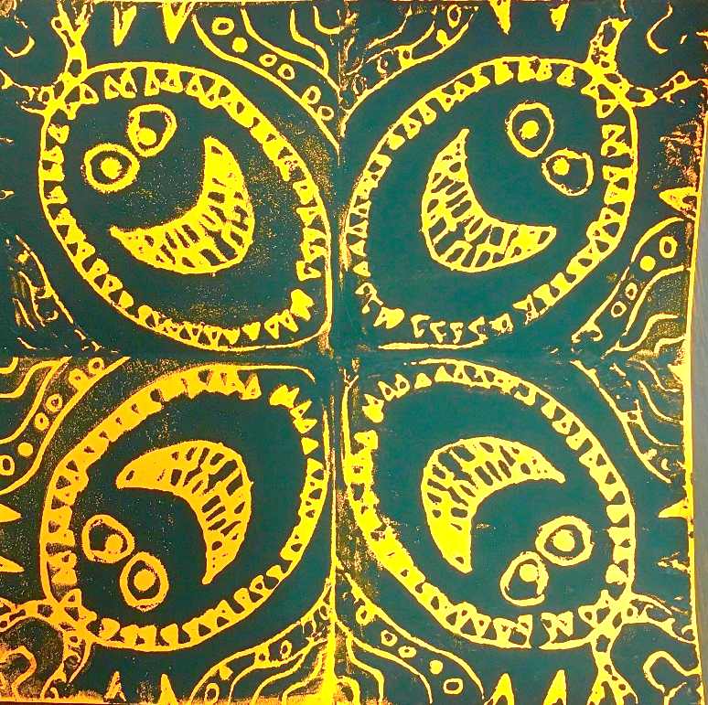
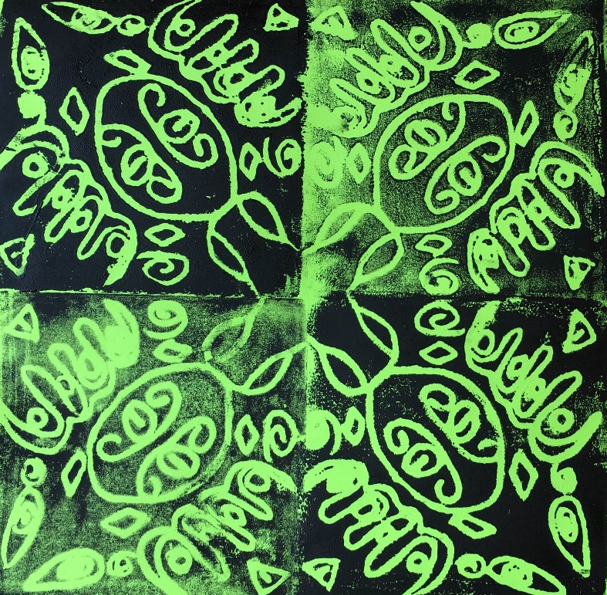
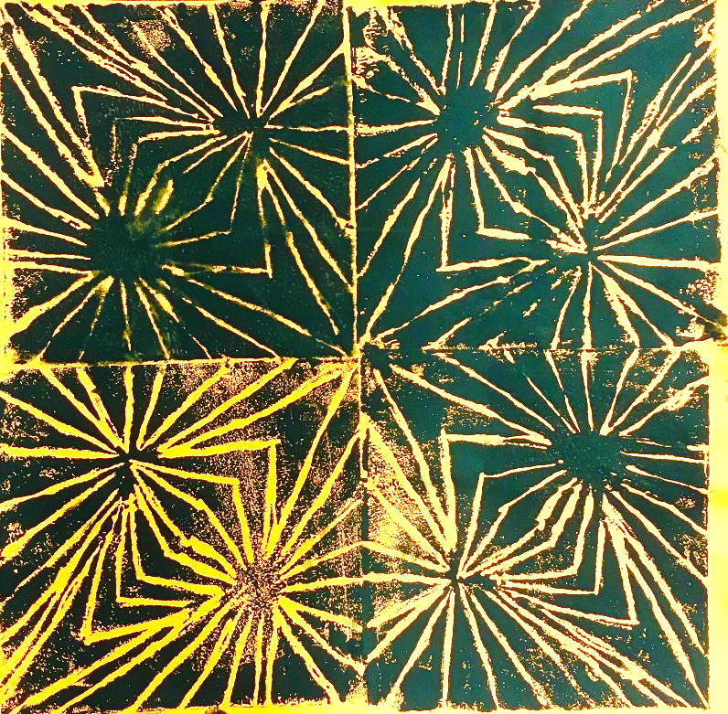
What do you notice about the artwork?

Slide 2
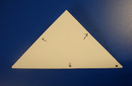
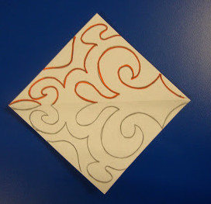
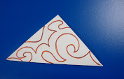
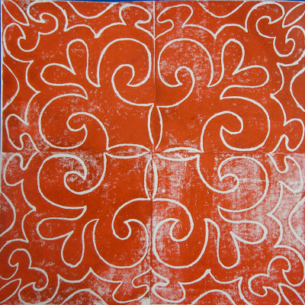
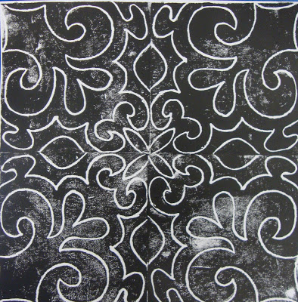
Sketch Steps:
Fold square into triangle.
Draw a design that fills and touches all 3 sides.
Trace design with markers.
Fold and trace on blank side.
Photos: http://art-paper-scissors.blogspot.com/2011/01/radial-symmetry-prints.html

Slide 3
Print Steps:
Draw dot with Sharpie for the center corner.
Spray paper with water.
Ink stamp.
Stamp with dot in the middle.
5. Use clean roller to press stamp down.
6. Repeat to fill the square.
Ask teacher to refill ink!
Clean-up:
1. Wash and dry stamp.
2. Put stamp in table bag.
3. Give artwork to teacher to put on drying rack.

Slide 4
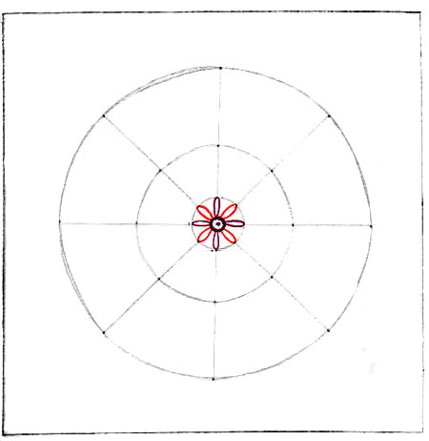
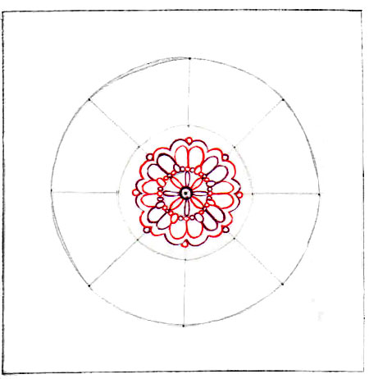
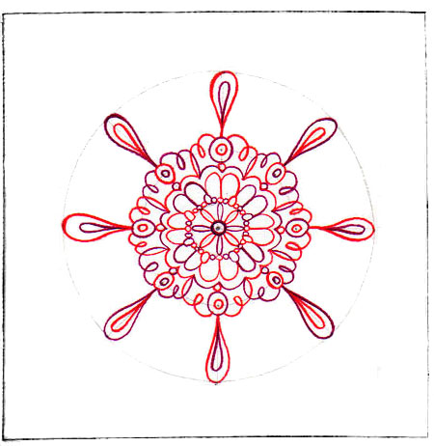
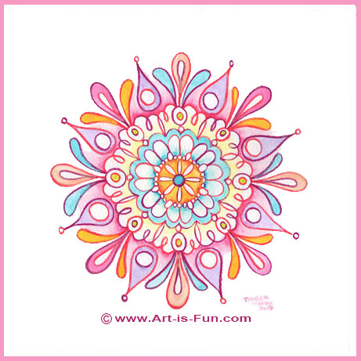
Sketchbook Project: Finish a previous sketchbook project.
Draw a mandala on circle graph paper. Color it in with marker or colored pencil.
Staple it into your sketchbook.
Images: http://www.art-is-fun.com/how-to-draw-a-mandala/

