Slide 1
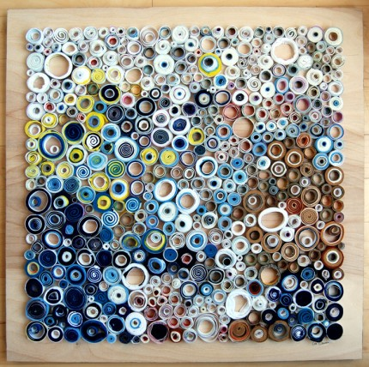
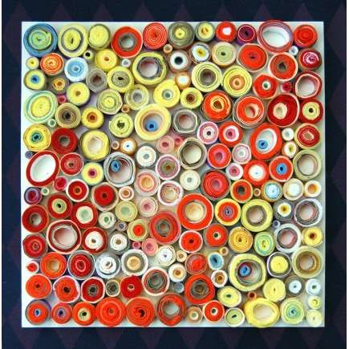
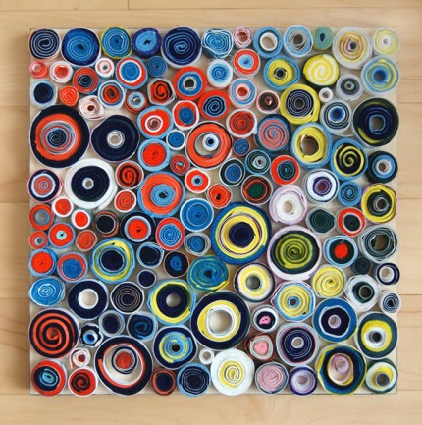
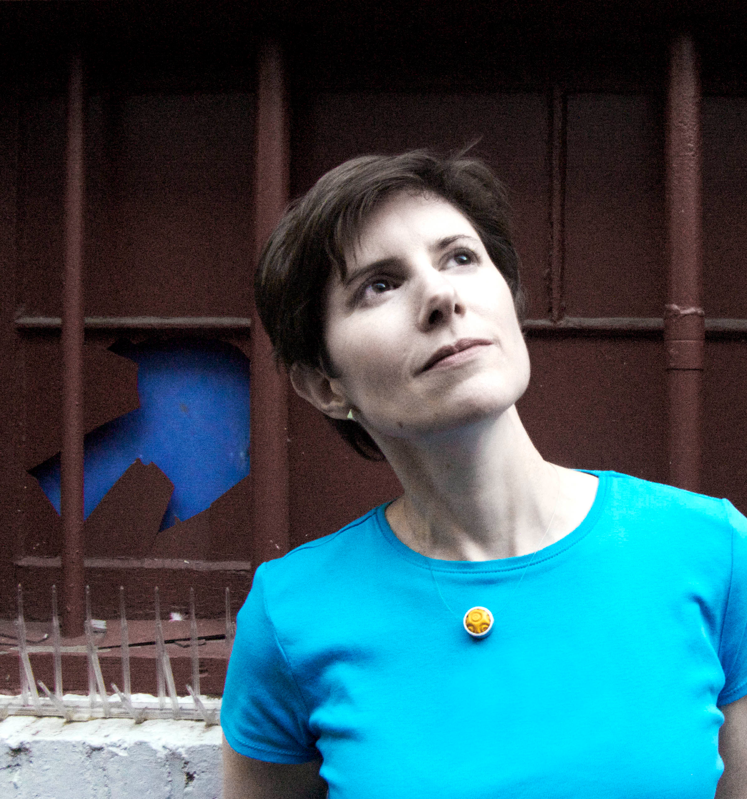
Lee Gainer
What do you notice about the art?

Slide 2
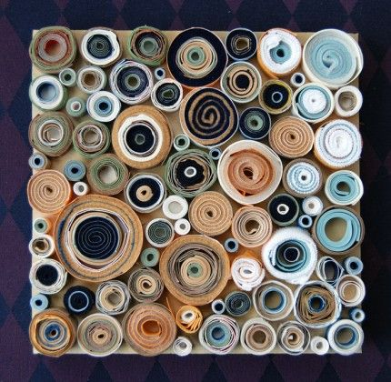
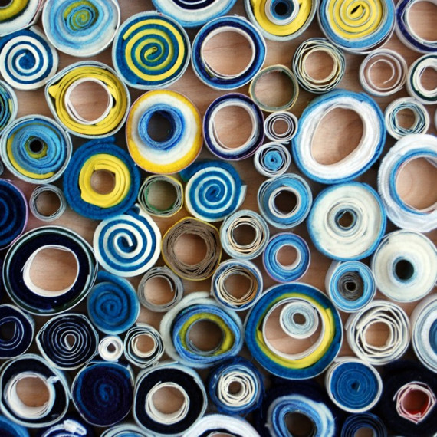
Finish previous project or draw a sketchbook page.
Write your table name and teacher name on cardboard.
3. Pull 4 colors for artwork. Tape them to the back.
4. Paint cardboard.
5. Draw a sketchbook page.

Slide 3
Fill your cardboard with circles.
Turn in the cardboard and wipe down your table.
Draw a sketchbook page.

