Slide 1
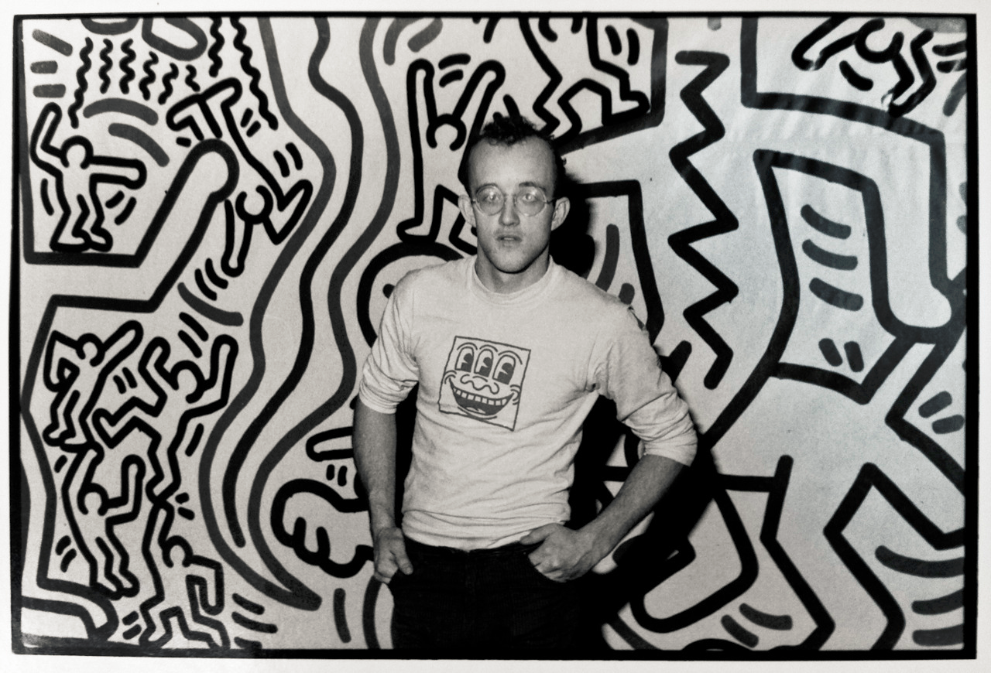
He made more than 50 large pieces of public artwork.
He opened a store called “Pop Shop” that sold his art.
He was diagnosed with AIDS and started a foundation that used his art to raise awareness about AIDS.
Keith Haring

Slide 2
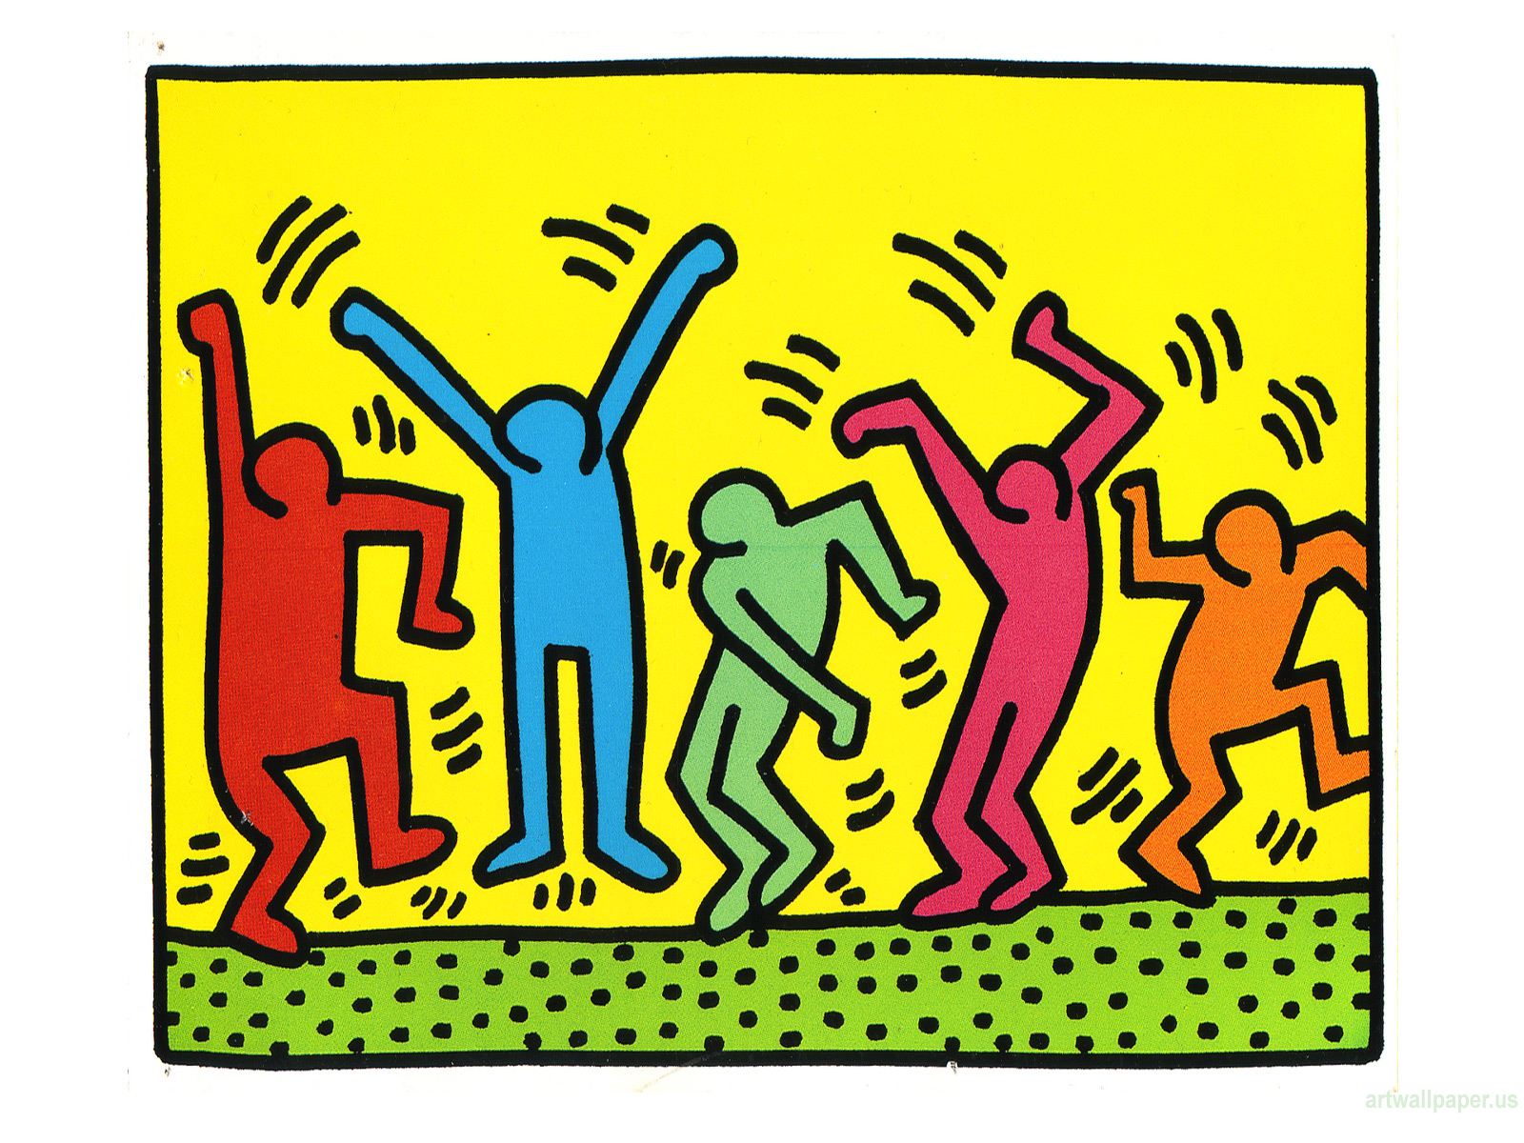
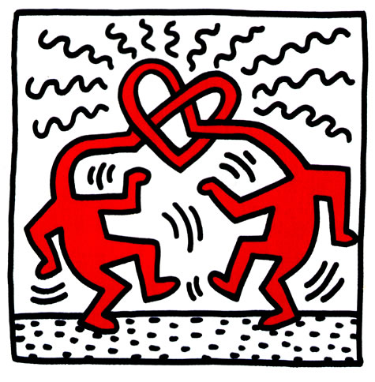
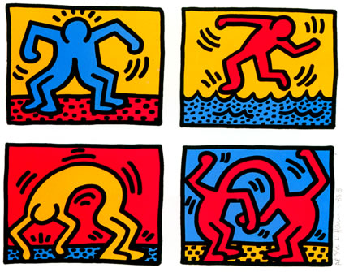
Untitled, Keith Haring
Untitled, Keith Haring
Pop Shop Quad II, Keith Haring
Pick a painting.
What emotions does the painting make you think of?

Slide 3
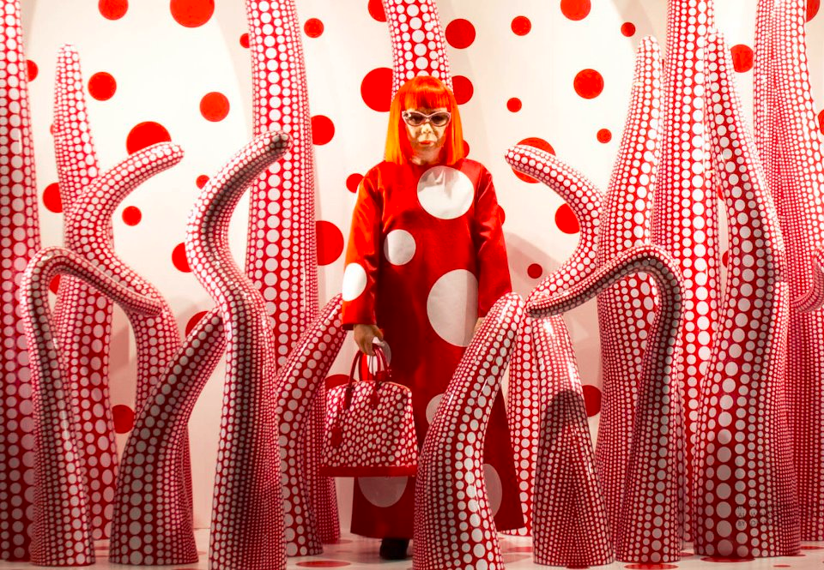
She creates installations – rooms filled with sculptures and paintings that people can walk through.
She was born in Japan.
She is still creating artwork at the age of 87.
Yayoi Kusama

Slide 4
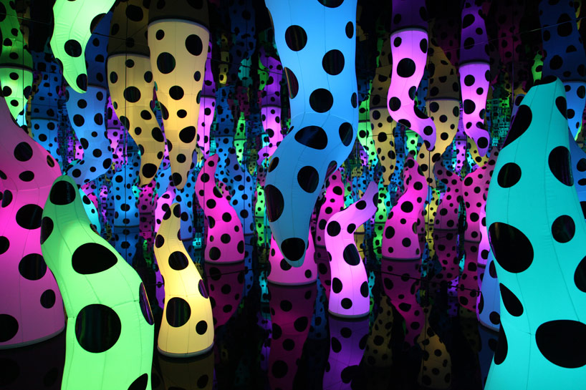
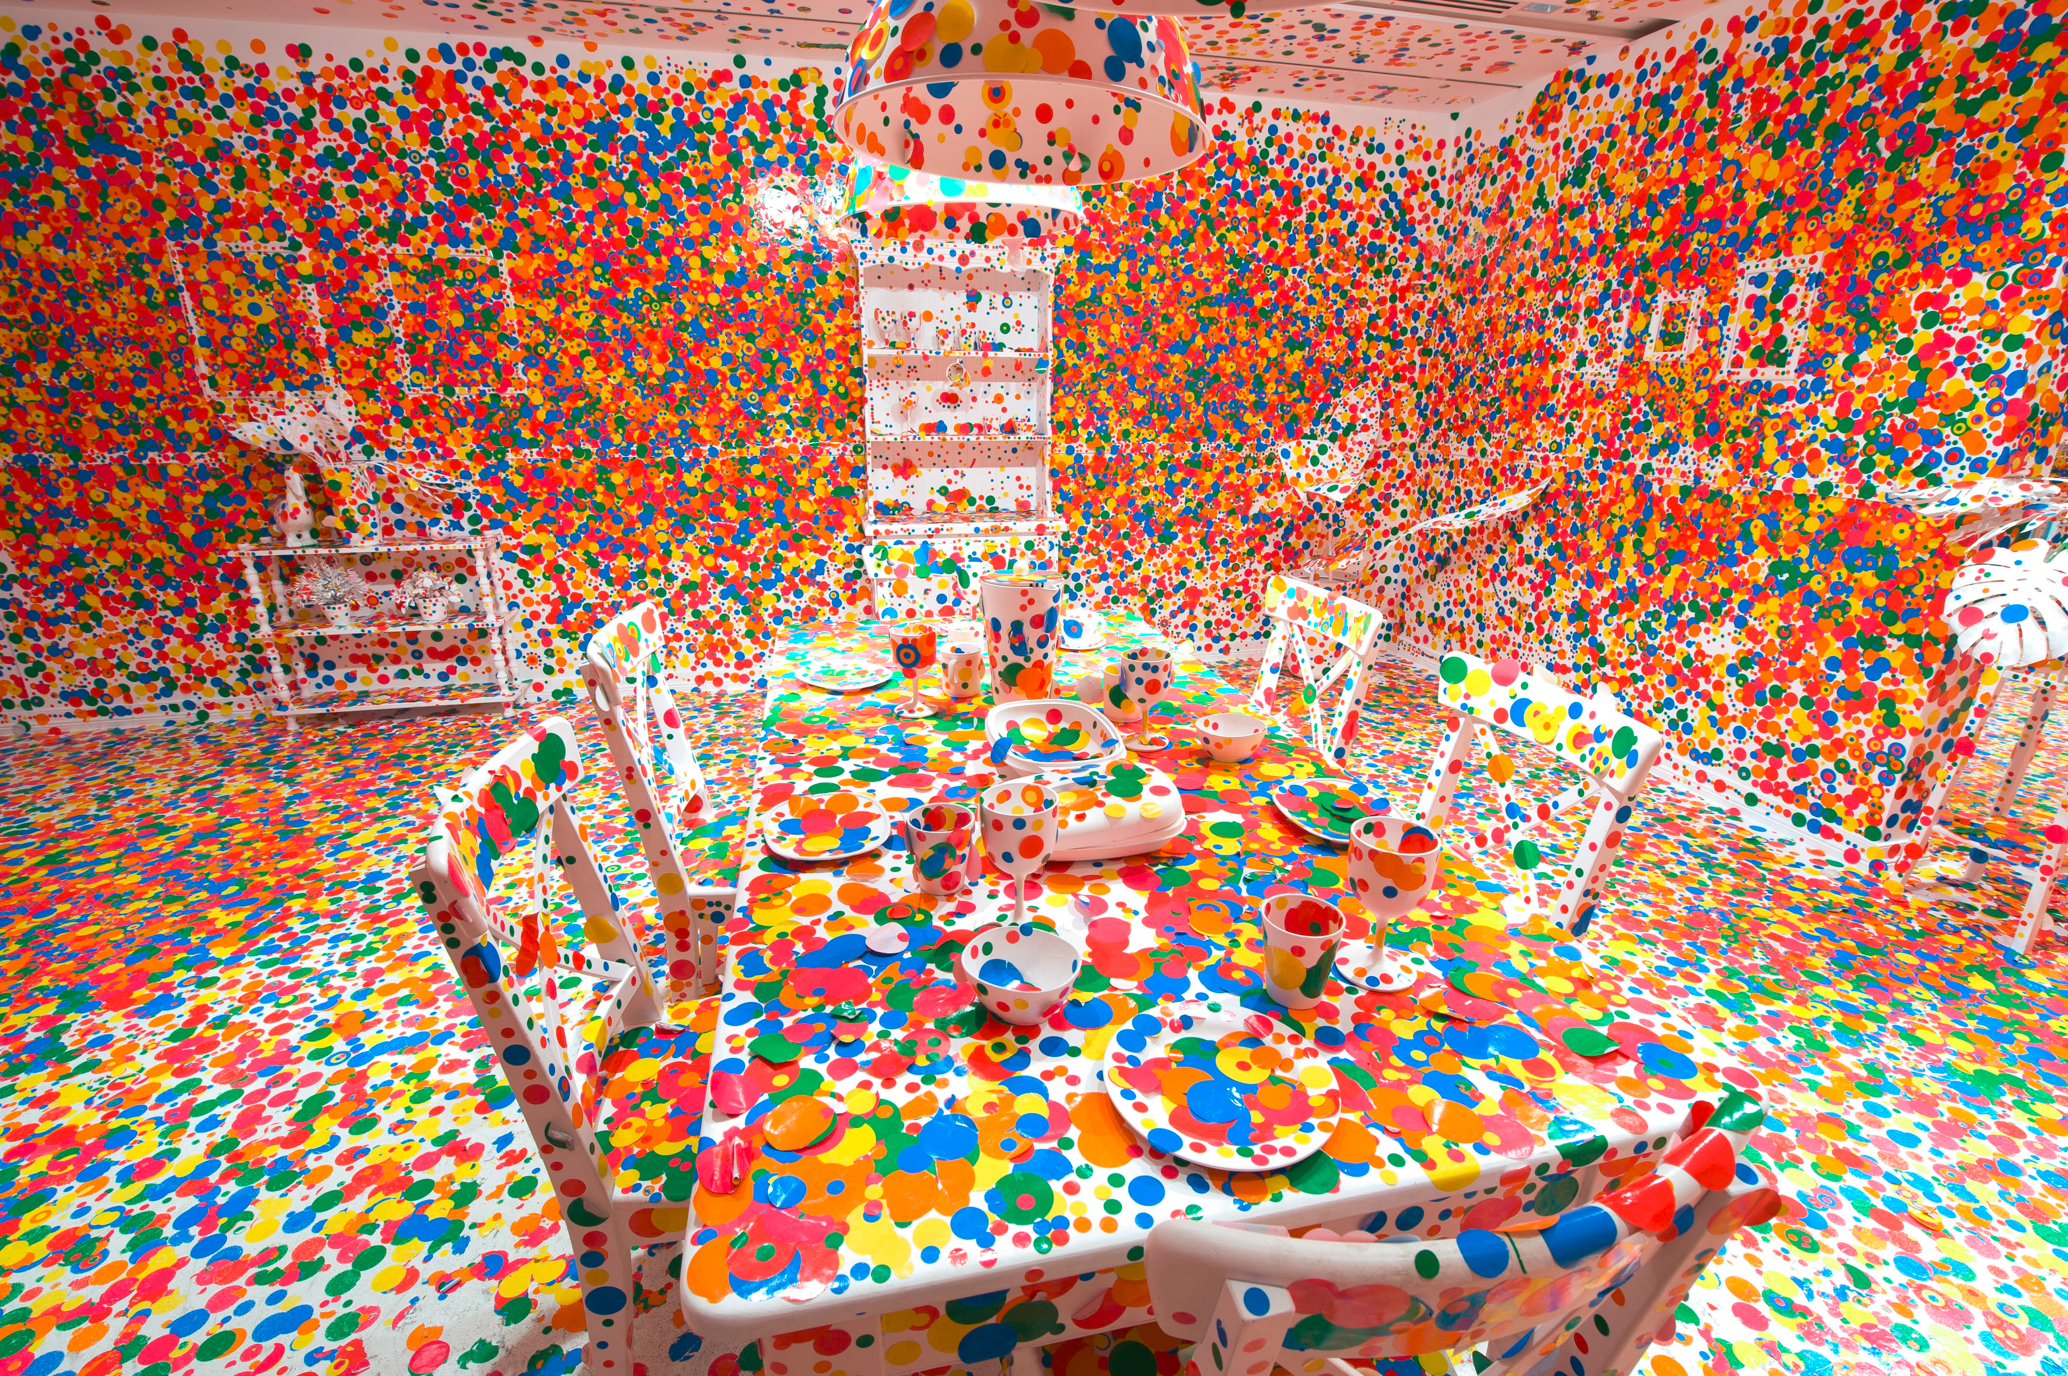
Love is Calling, Yayoi Kusama
The Obliteration Room, Yayoi Kusama
Which installation would you want to visit? Why?

Slide 5
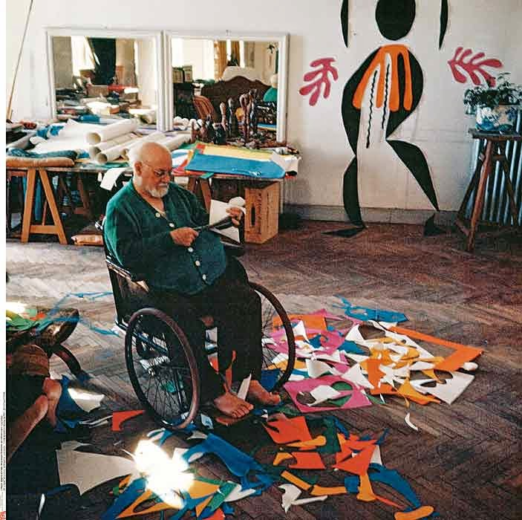
He was born in France in 1869.
He painted his artwork using crazy, unrealistic colors.
In his old age, he couldn’t paint any more. He began making art by cutting paper.
Henri Matisse

Slide 6
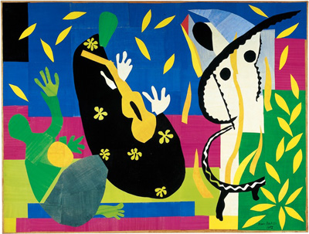
If this artwork was a song, what would it sound like?
Sorrow of the Kings, Henri Matisse

Slide 7
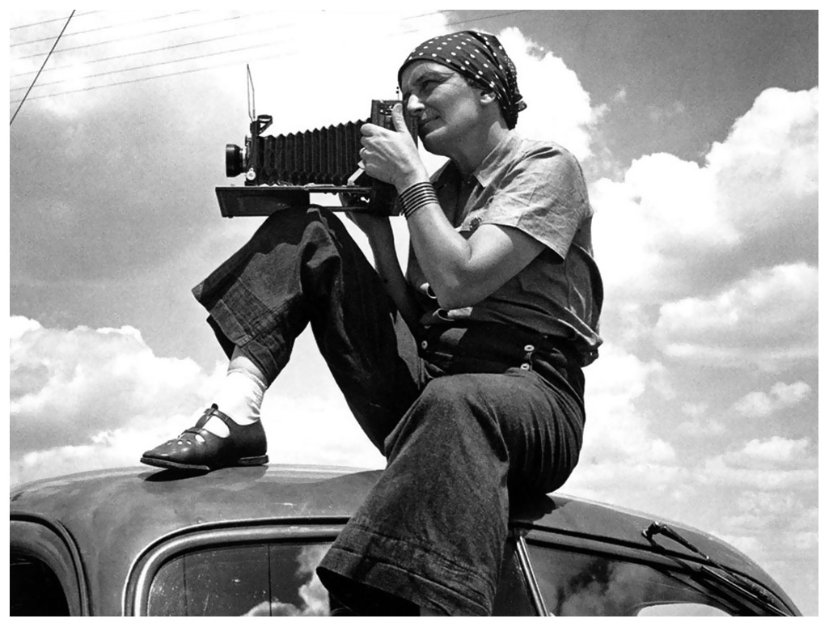
She was sick with polio at the age of 7. Her right leg and foot were injured.
Her father abandoned her and her mom when she was a teenager.
She documented the struggles of people during the Great Depression.
Dorothea Lange

Slide 8
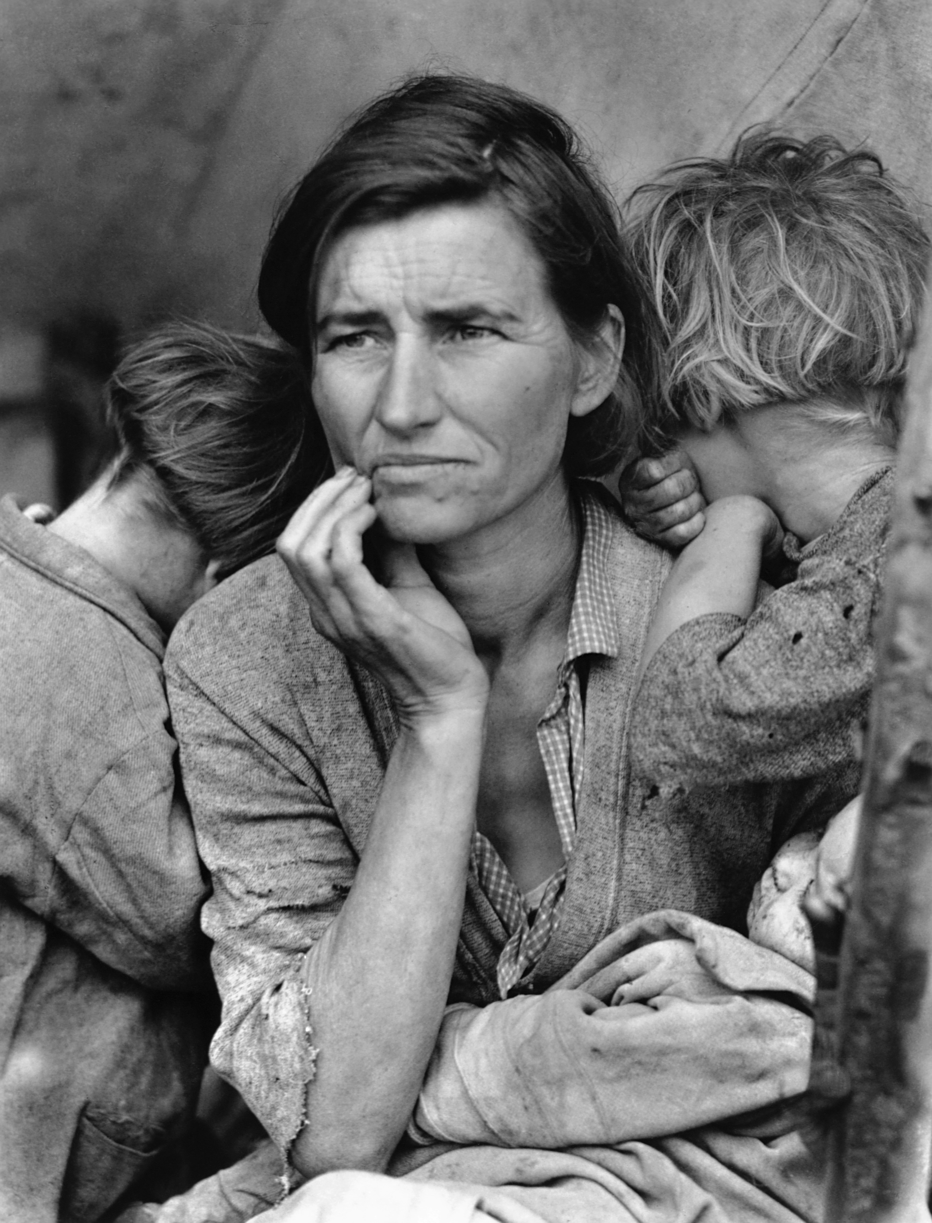
What do you think this family is thinking and feeling?
Migrant Mother, Dorothea Lange

Slide 9
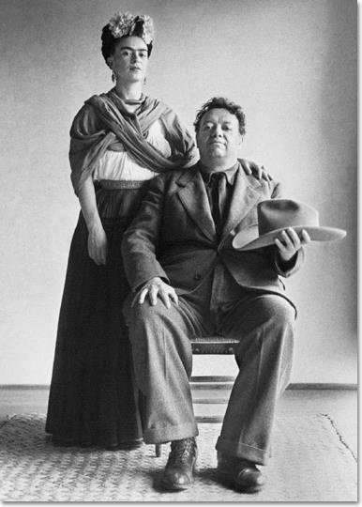
He was married to Frida Kahlo. They had a difficult relationship.
He painted murals – large paintings that fill a wall.
His artwork focused on the political, social and historical struggles of Mexico.
Diego Rivera

Slide 10
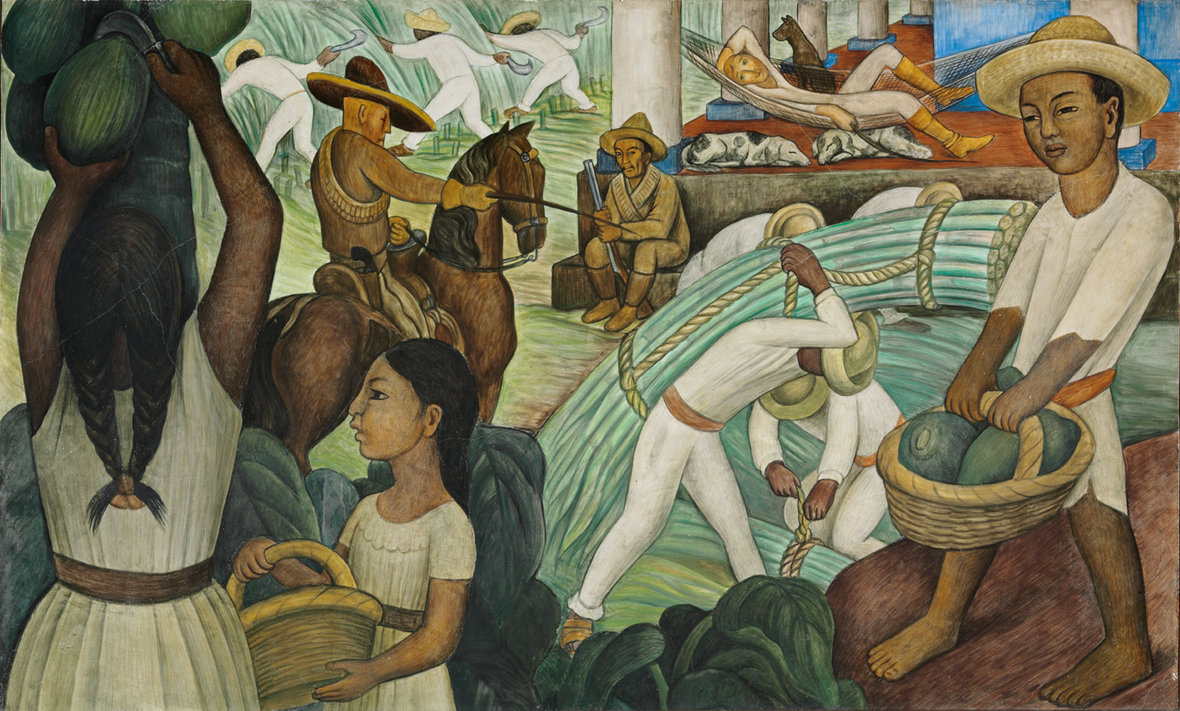
Sugar Cane, Diego Rivera
What do you think is happening?

Slide 11
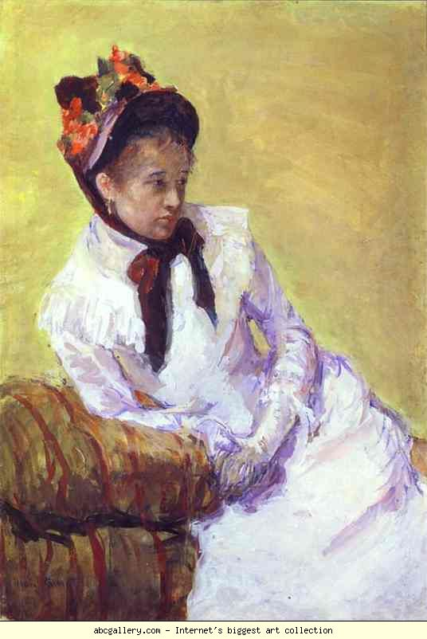
Her father did not want her to study art in Paris.
She studied painting by copying famous artwork at the Lourve, a museum in Paris.
She became friends with Edgar Degas and began painting in the style of Impressionism.
Mary Cassatt

Slide 12
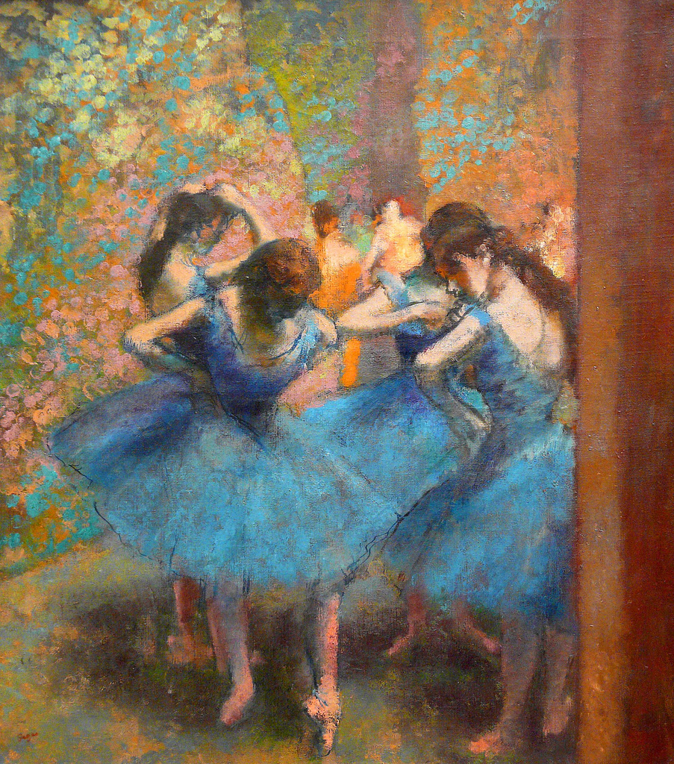
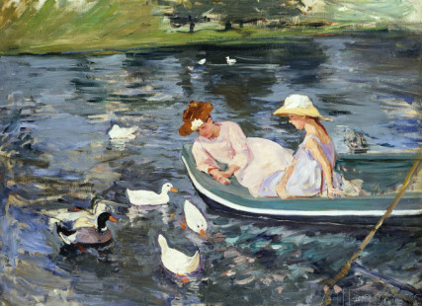
How are these the same? How are they different?
Summertime, Mary Cassatt
Dancers in Blue, Edgar Degas

