Slide 1
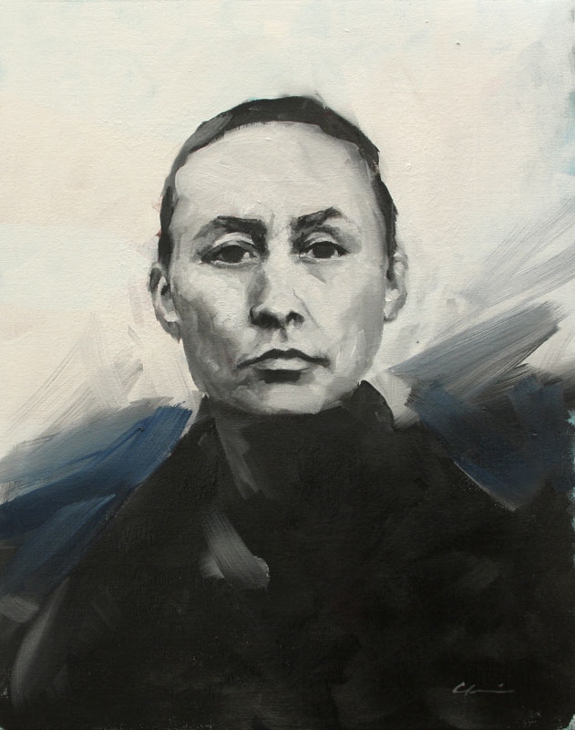
Georgia O’Keeffe
An American artist during the early 20th century.
Famous for up-close paintings.
Inspired by nature and the landscape of New Mexico.

Slide 2
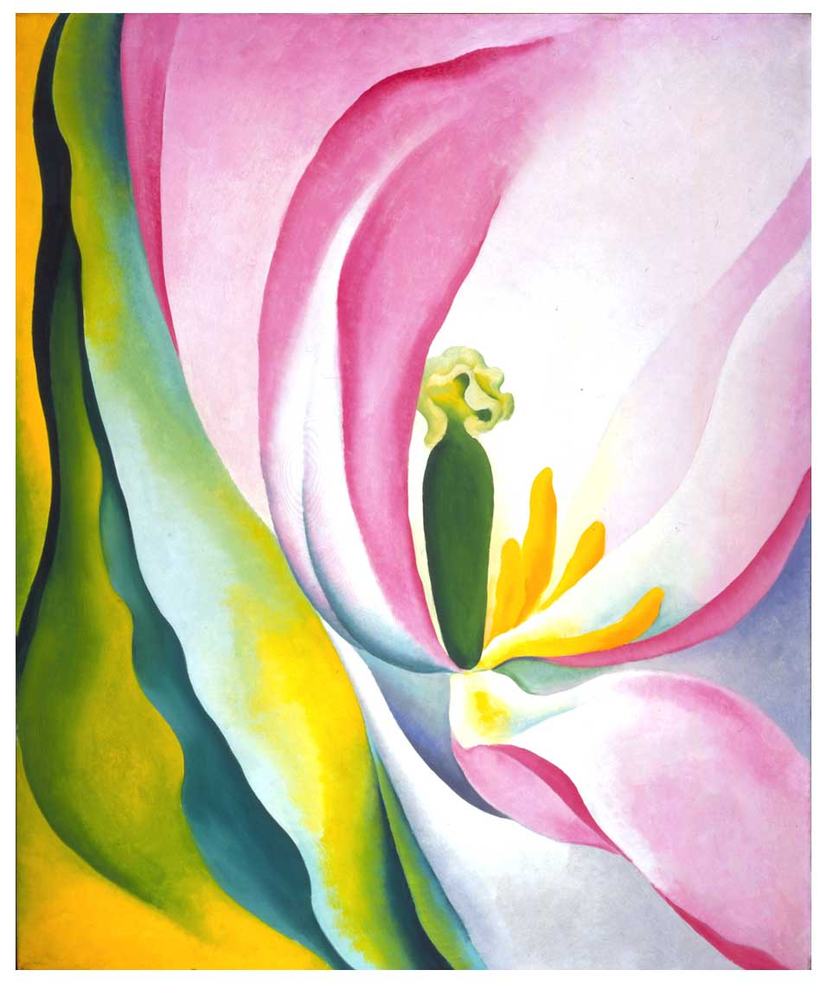
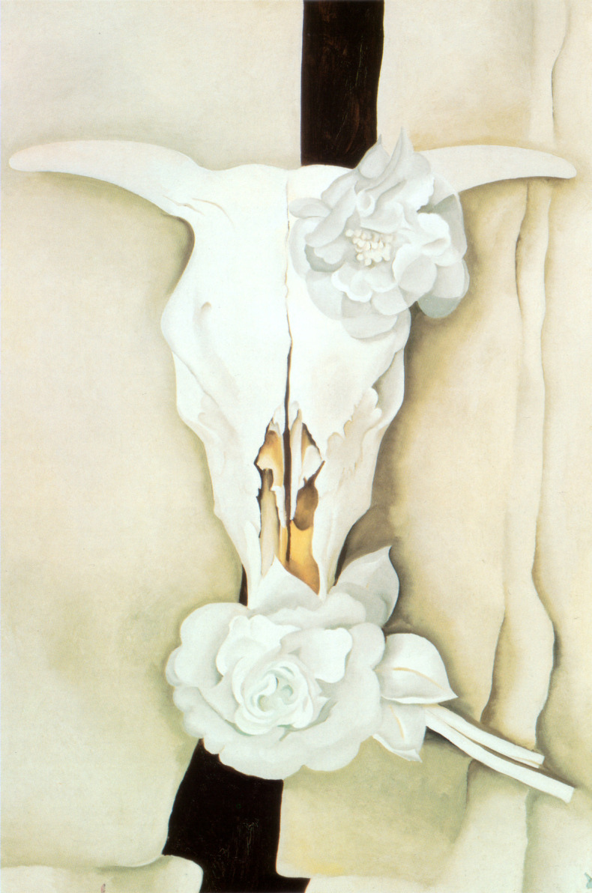
What do these paintings have in common?
Cow’s Skull with Calico Roses, Georgia O’Keeffe
Pink Tulip, Georgia O’Keeffe

Slide 3
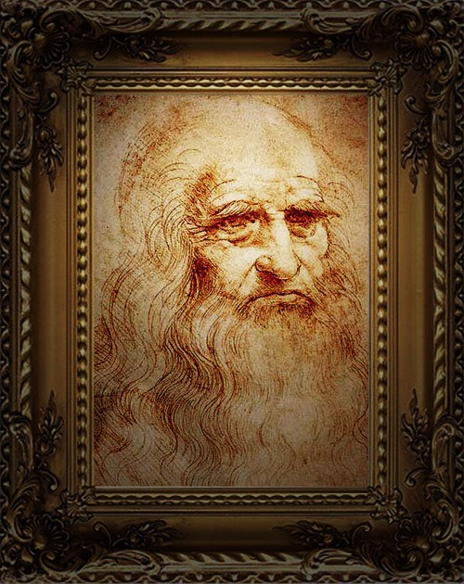
Leonardo da Vinci
An artist during the Renaissance in Italy.
A painter, engineer, inventor.
Wrote backwards in his sketchbooks so that only he could read it (with a mirror).

Slide 4
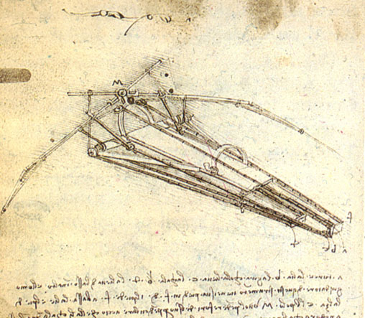
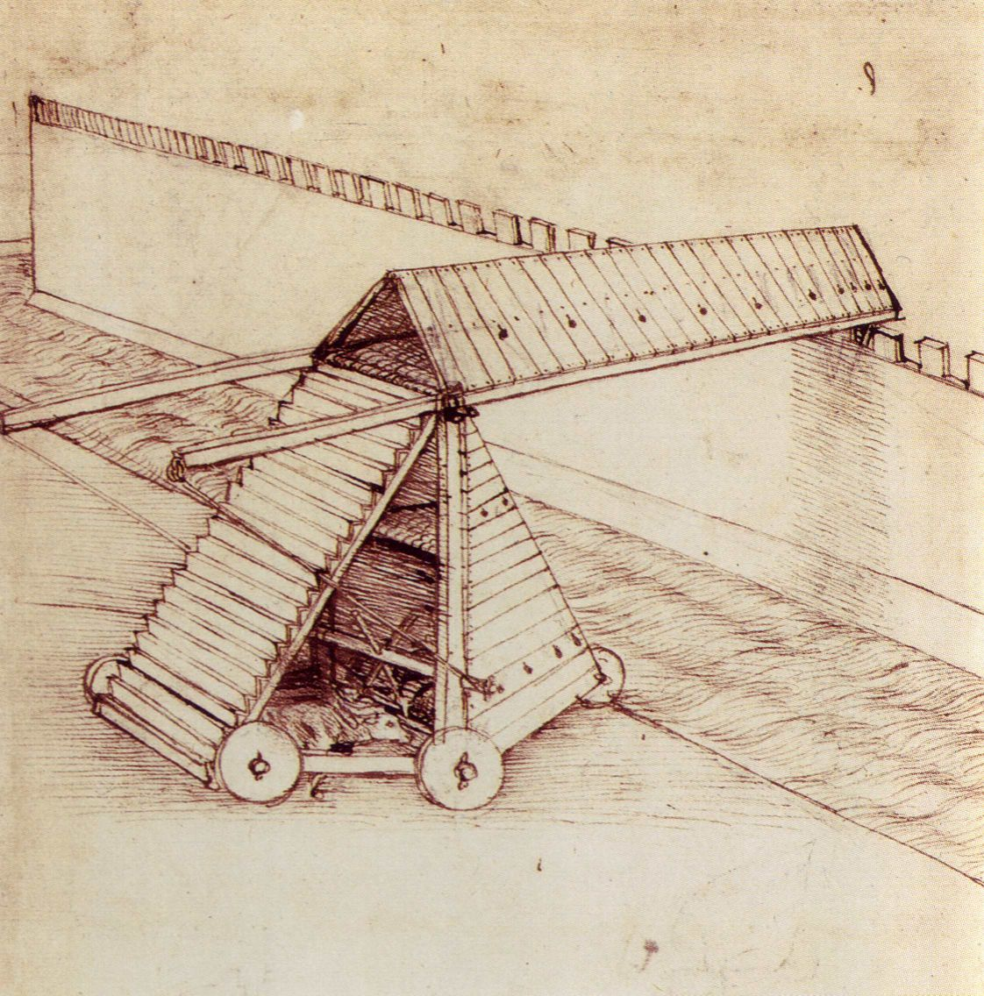
What do you think these inventions could be used for?
Pages from da Vinci’s Sketchbooks

Slide 5
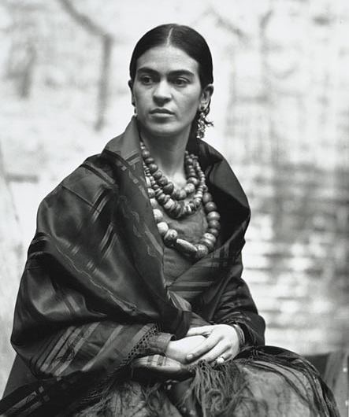
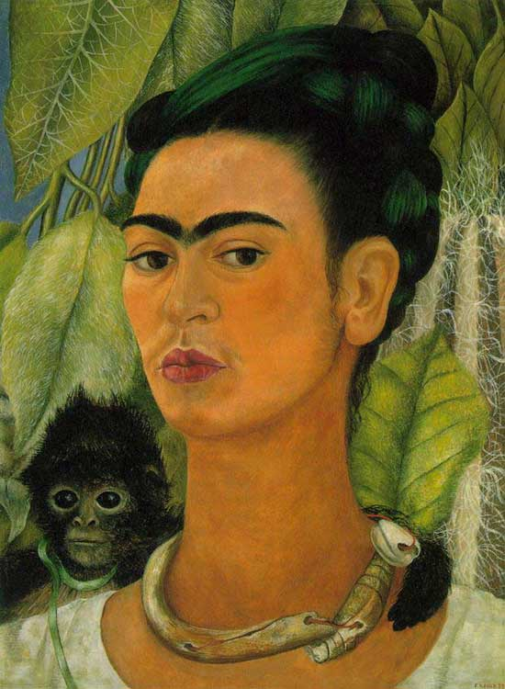
Frida Kahlo
She was born and lived in Mexico.
She had polio as a child and was in a serious bus accident.
Married to another artist, Diego Rivera.

Slide 6
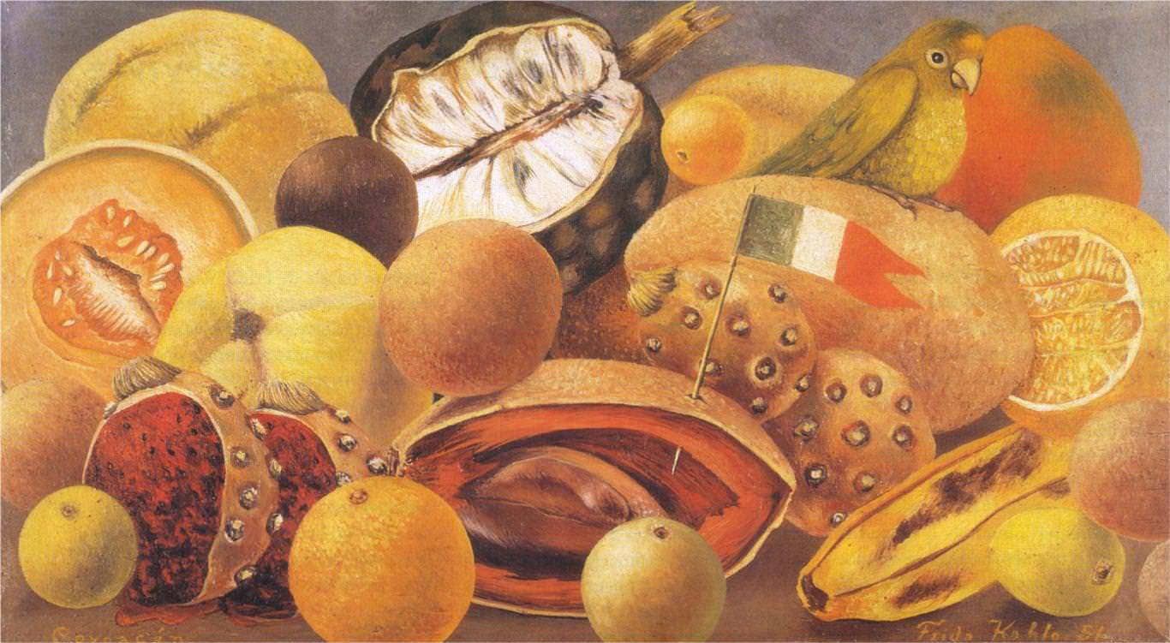
Still Life with Parrot and Flag, Frida Kahlo
What do you notice about the painting?

Slide 7
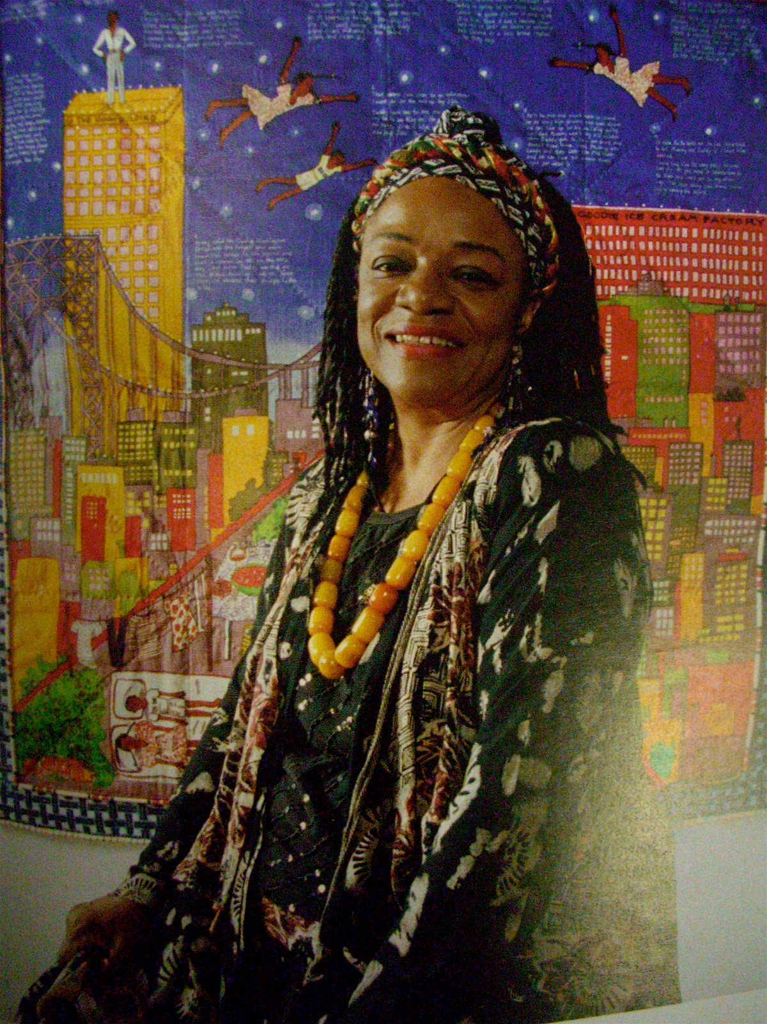
Faith Ringgold
She created painted story quilts.
She learned how to sew from her mother, who was a fashion designer.
Her paintings were turned into books.

Slide 8
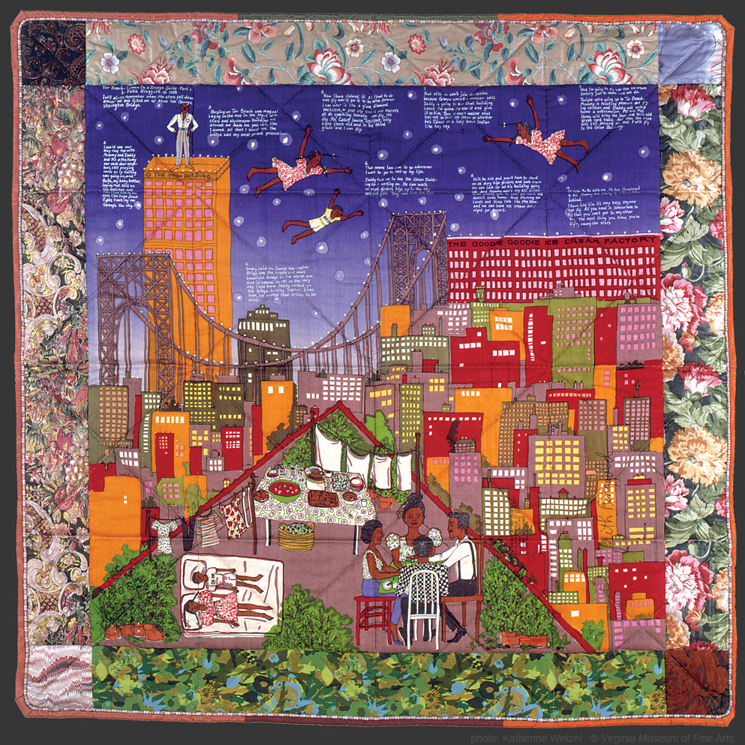
Describe what story the painting is telling.
Tar Beach 2, Faith Ringgold

Slide 9
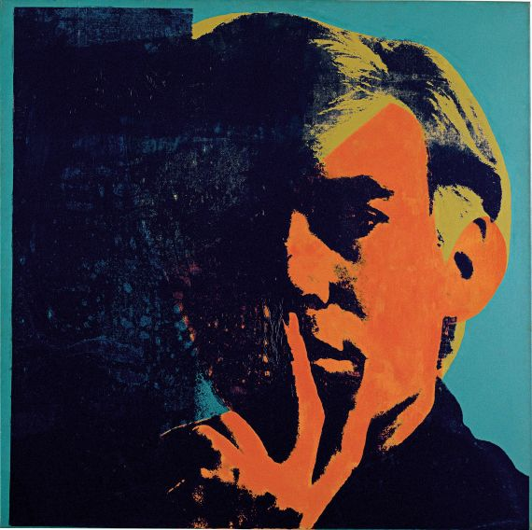
Andy Warhol
He used screen-printing to create artwork.
Printmaking allowed him to make multiple copies of a picture.
He was part of the Pop Art movement.

Slide 10
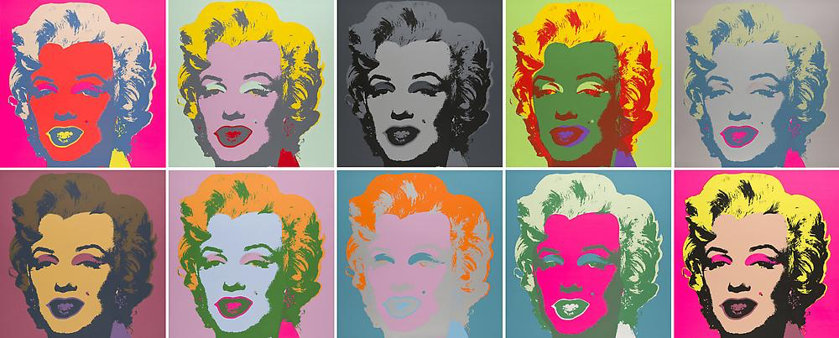
Why do you think Warhol chose these colors?
10 Marilyns, Andy Warhol

Slide 11
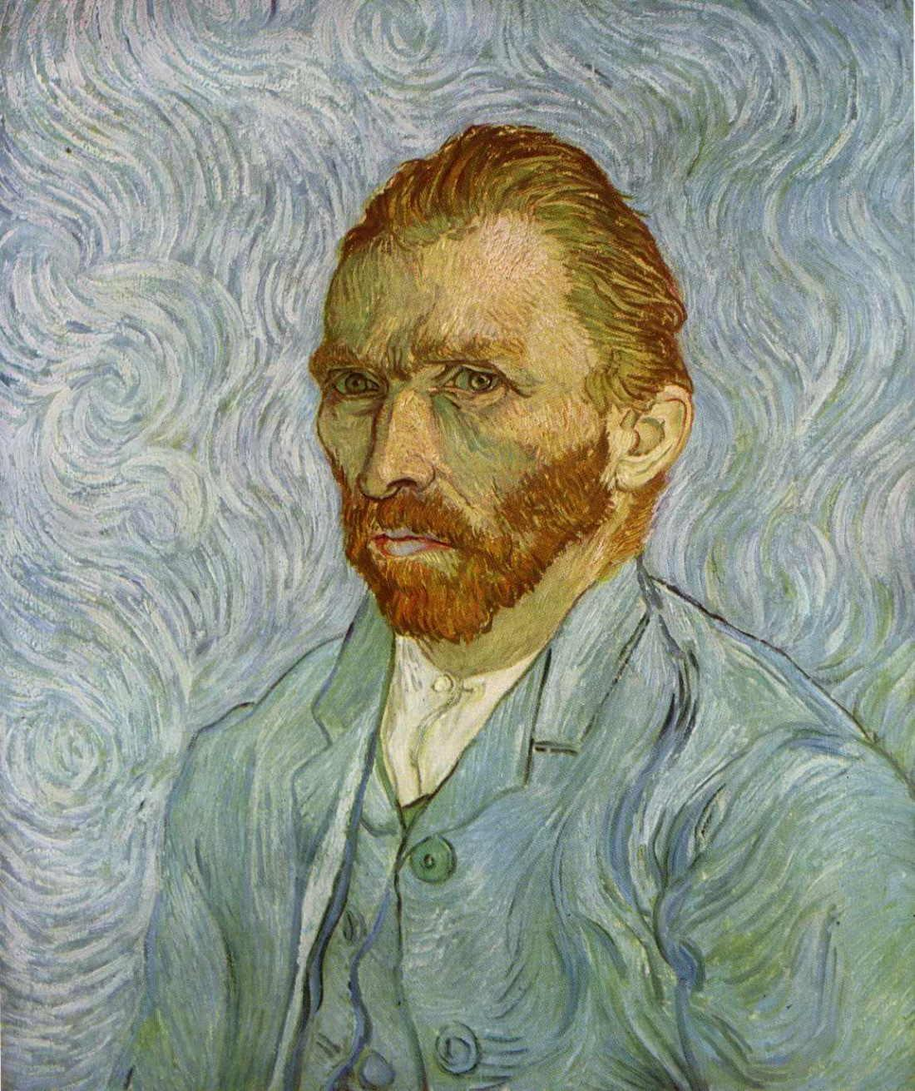
Vincent Van Gogh
Painted using thick paint, bright colors.
Painted The Starry Night in 1889.
Was poor and unknown during his life.

Slide 12
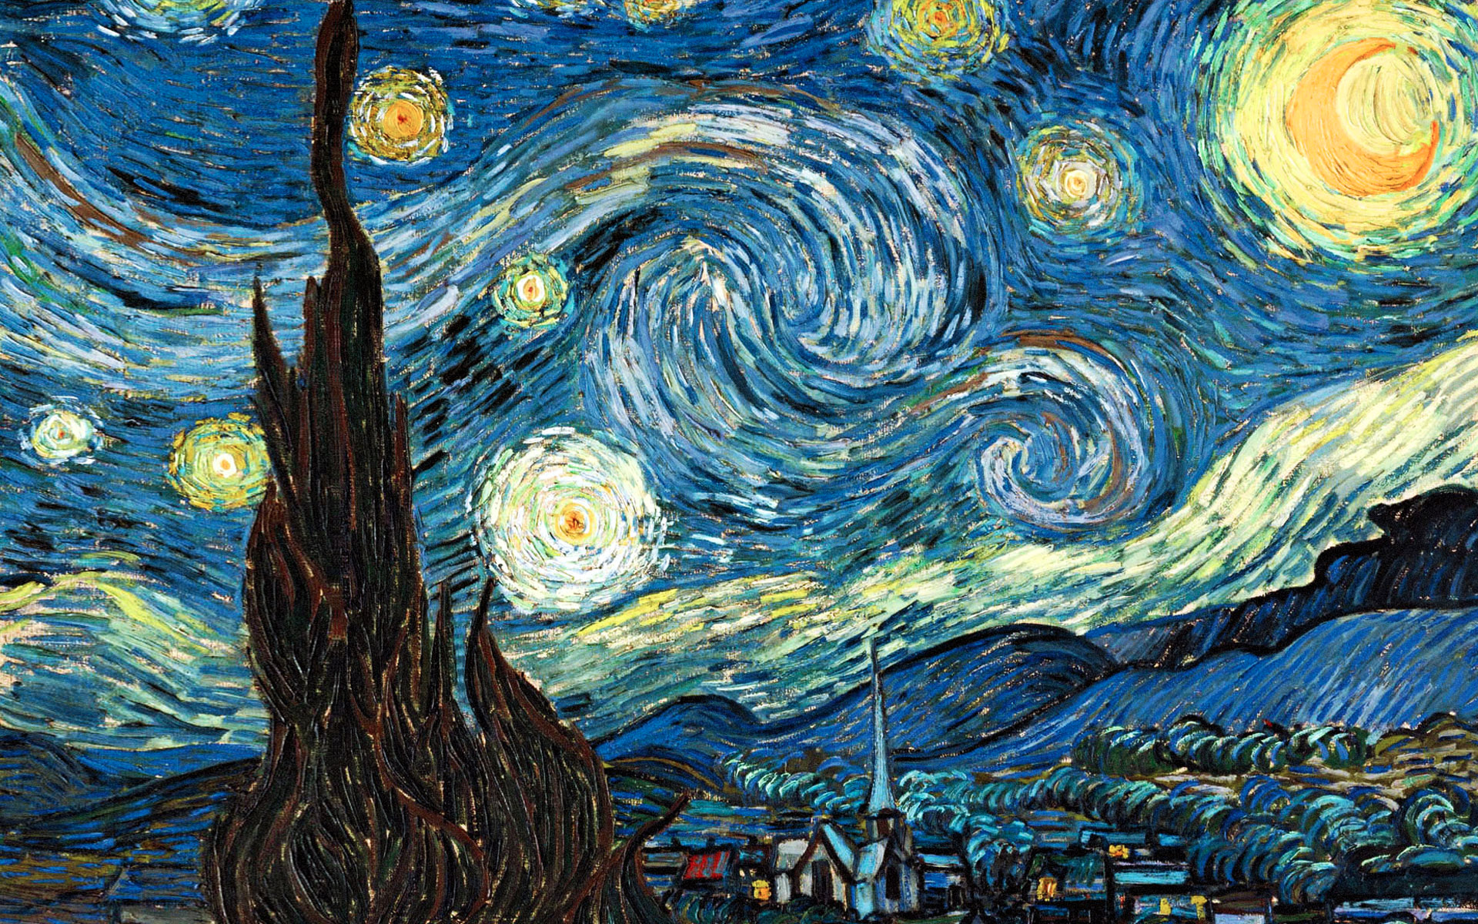
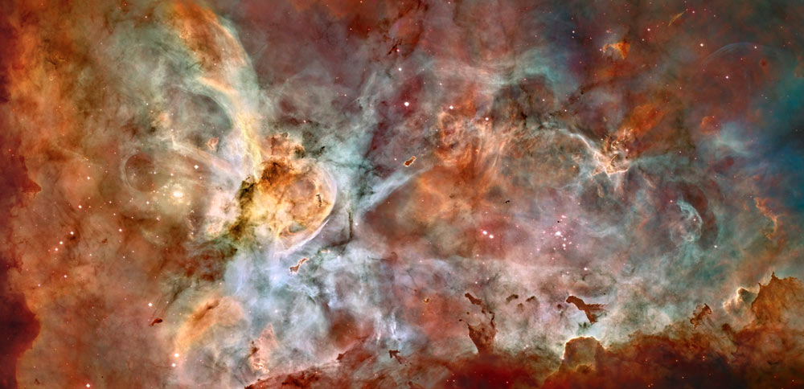
What do the images
have in common?
The Starry Night, Vincent van Gogh
Hubble Telescope Photograph
Carina Nebula
A nebula – concentration of dust and gas in outer space
This photo shows a star being born

