Slide 1
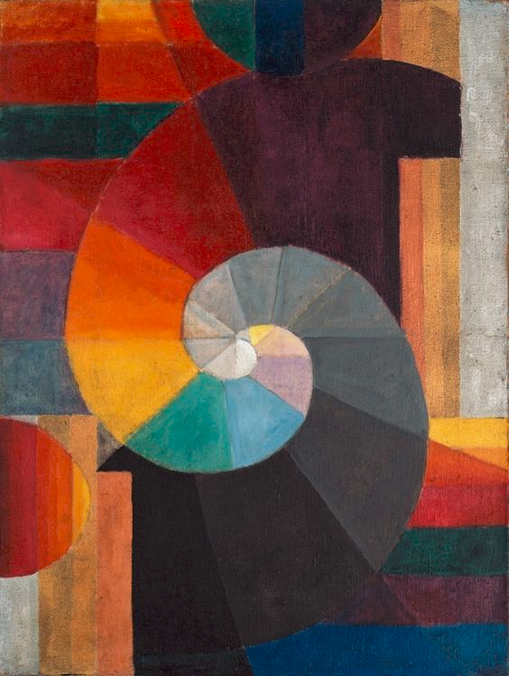
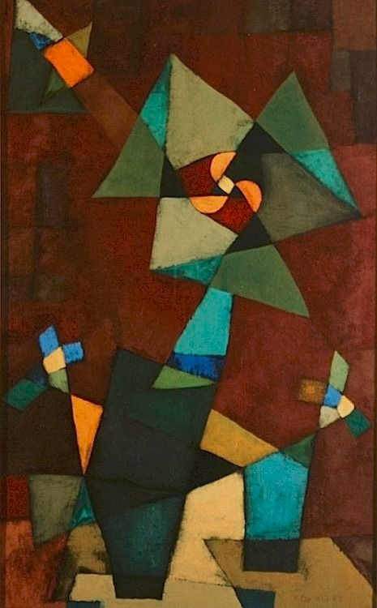
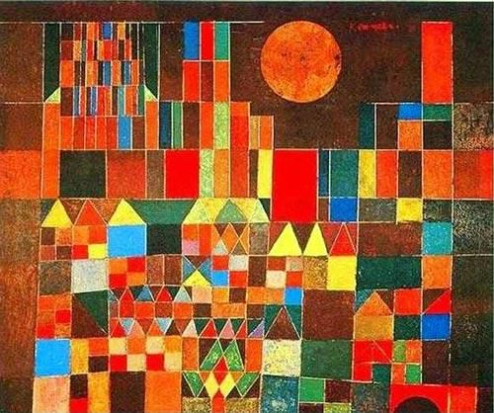
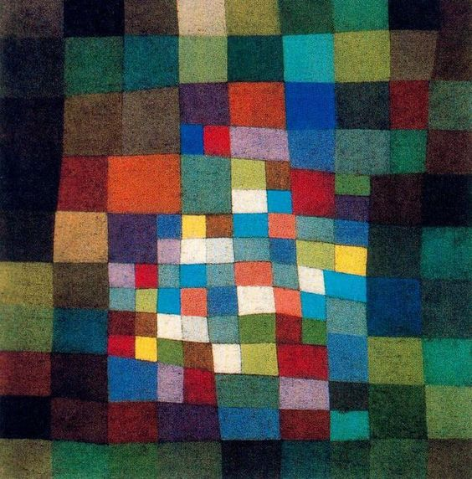
Paul Klee

Slide 2
Fill your paper with shapes.
Color in the shapes with watercolor crayon.
Paint over the shapes with a paintbrush.
Draw and color a sketchbook page.

