Slide 1
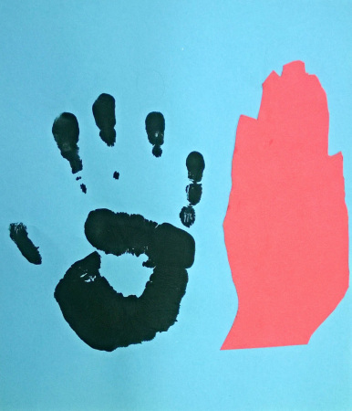
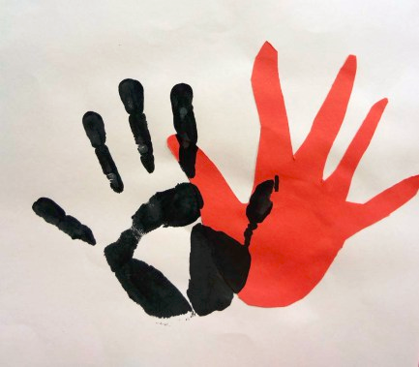
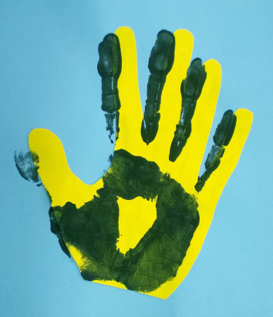
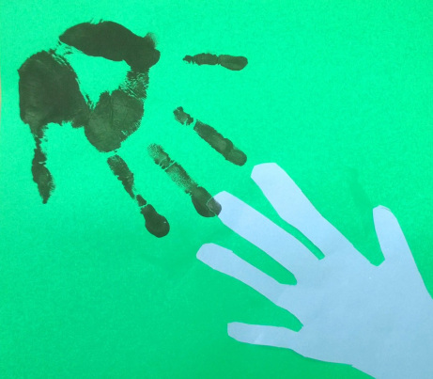
Printmaking:
stamping an image onto paper

Slide 2
Sketchbook Project:
Draw a crime scene where something was stolen.
One of the clues is a handprint.
Your Name
Homeroom Teacher

Slide 3
Sketchbook Project:
Draw a crime scene where something was stolen.
One of the clues is a handprint.

