Slide 1
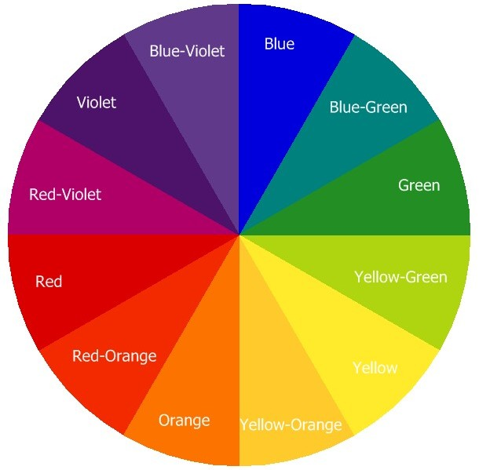
Color Theory: Analogous Colors
(Colors that are next to each other)
Teacher 1: Red-Violet, Red, Red-Orange
Teacher 2: Red-Orange, Orange, Yellow-Orange
Teacher 3: Yellow-Orange, Yellow, Yellow-Green
Teacher 4: Yellow-Green, Green, Blue-Green
Teacher 5: Blue-Green, Blue, Blue-Violet
Teacher 6: Blue-Violet, Violet, Red-Violet

Slide 2
Color Theory: Complementary Colors
(Colors that are across from each other)
Teacher 1: Red, Green
Teacher 2: Orange, Blue
Teacher 3: Yellow, Violet
Teacher 4: Green, Red
Teacher 5: Blue, Orange
Teacher 6: Violet, Yellow

